Slide 1

NON PROFIT ACCOUNTING

Slide 2
Introductions

Slide 3

Dan Sills
President and CEO of O|Miga
More than forty years of finance and accounting experience in various roles and industries
Co-founder of Community Value Alliance
Credentials
  BA in Business from University of Notre Dame
  Certified Public Accountant

Slide 4
Linda A. Moder
Director Operations at O|Miga.
More than twenty years of finance and accounting experience in various roles and industries
Lead the O|Miga team in providing excellent quality service to clients
Credentials
  BA in Mathematics from St. Louis University
  MBA in Finance from St. Louis University
  Licenses
    Certified Public Accountant (CPA)
    Real Estate (referral)

Slide 5

Goals and Objectives

Slide 6
Class Overview
Non Profit vs Not for Profit vs For Profit
Governance
First Steps
Accounting
  Accounting 101
  Financial Statements
  Oversight
  Revenue
  Budgeting
  Best Practices
  Ratios
Tax

Slide 7
Non-Profit vs
Not For Profit vs For Profit Entities

Slide 8
What is a Non Profit?
A nonprofit organization (NPO) is a legal entity organized and operated for a collective, public or social benefit.
A nonprofit is subject to the non-distribution constraint: any revenues that exceed expenses must be committed to the organization's purpose, not taken by private parties.
Array of nonprofits include:
  Political organizations
  Schools,
  Business associations
  Churches
  Social clubs
  Consumer co-operatives

Slide 9

Key aspects of nonprofits are :
  accountability,
  trustworthiness,
  honesty, and openness to every person who has invested time, money, and faith into the organization.
Nonprofit organizations are accountable to the donors, founders, volunteers, program recipients, and the public community.

Slide 10
Advantages and Disadvantages
Advantages of Non-Profit Organizations
  Allows You to do a Good Deed
  Tax Exempt Status
  Limited liability
  Can receive grants and donations
Challenges of Non-Profit Organizations
  Competition for Funding
  Public Scrutiny
  Possible below market pay
  Possible understaffing
Notes:
Now we can compare and contrast the non-profit to the for-profit entities. As a reminder, non-profits and for-profits both strive to have positive net income. That is revenue greater than expenses, but there are distinct differences after that

Slide 11
Common Types of Non Profits
Technically under the IRS’s 501(c)code, there are two main types of nonprofits:
  nonprofit organization (NPO) -- serve the public via goods and services
  not for profit organization (NFPO)-- may serve just a group of members
Other types include:
  Section 501(c)(4): civic leagues and social welfare organizations, homeowners’ associations, and volunteer fire companies.
  Section 501(c)(5): such as labor unions
  Section 501(c)(6): such as chambers of commerce.
  Section 501(c)(7): such as Social and Recreational Clubs
  Section 501(k): childcare-related organizations.

Slide 12
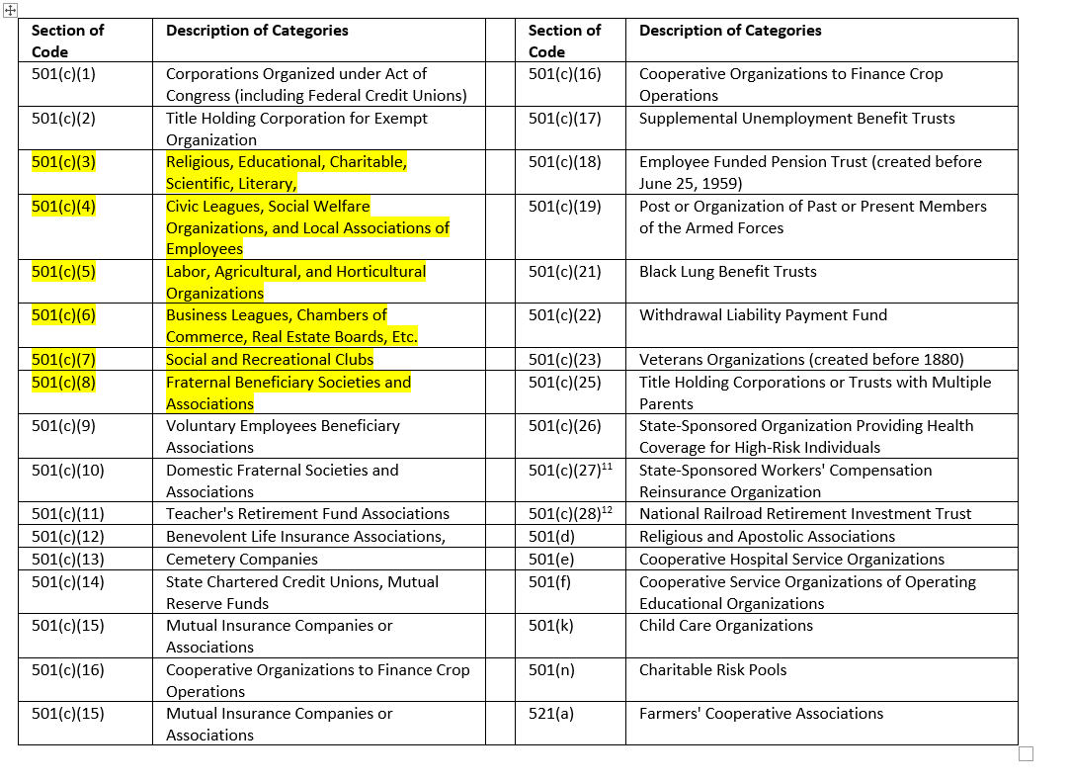
Non-Profit Codes

Slide 13
What is a Not For Profit (NFPO)
IRS definition is an organization engaged in a specific activity such as a hobby and may include clubs, groups or associations
Does not seek to make a profit
Any income generated can be distributed among the members
Notes:
Not for Profit – a very similarly sounding name, but The IRS has specifically designated these organizations

Slide 14
What is a For Profit
Operates with the goal of making money.
Most businesses are for-profits that serve their customers by selling a product or service.
The business owner earns an income from the profit and may also pay shareholders and investors from the profits.

Slide 15
Comparison Non-Profit and For Profit
Non-Profit
  Aim is to improve society’s well being
  Not owned by anyone
  Does not pay out dividends or profit
  Income utilized to pay for organization’s activities and meet expenses
  Exempt from income taxes
For Profit
  Aim is to maximize profits
  Owned by shareholders/partners/members
  Can pay out dividends to shareholders/profit sharing to employees
  Pay taxes
Notes:
Now we can compare and contrast the non-profit to the for-profit entities. As a reminder, non-profits and for-profits both strive to have positive net income. That is revenue greater than expenses, but there are distinct differences after that

Slide 16
Unrelated Business Income
Many nonprofit organizations have embraced more diverse revenue streams in recent years in an effort to diversify. While a significant net positive for many, this move may open your organization up to Unrelated Business Income Tax (UBIT).
Determining whether an activity qualifies as UBI demands that your organization understands the facts and circumstances of the activity. There are no specific rules: an activity considered UBI in one organization may not be considered UBI in another due to differing facts and circumstances

Slide 17
Three criteria determine whether the income from an activity is considered taxable:
Is the income from a trade or business?
The activity has to generate income. If an activity consistently generates losses and the organization does not expect it to be profitable, it’s not considered a trade or business and is therefore not UBI.
Is the activity regularly carried on?
If an organization devotes the same amount of time to an activity that a for-profit business would spend, it may be considered UBI.
Is the activity related to your exempt purpose?
Some activities, such as selling replicas of artwork in a museum gift shop, are typically considered to be related to the organization’s tax-exempt purpose and would not be considered UBI.
Others, such as renting out a parking lot for a nearby event, are not related and are therefore typically considered UBI.

Slide 18
The IRS defines UBI
According to the IRS, an activity generally is an unrelated business and its income, therefore, is subject to UBI tax if the activity is a trade or business carried on regularly, and not substantially related to furthering your nonprofit’s exempt purpose. Typically, all three factors must exist for the income to be considered UBI.

Slide 19
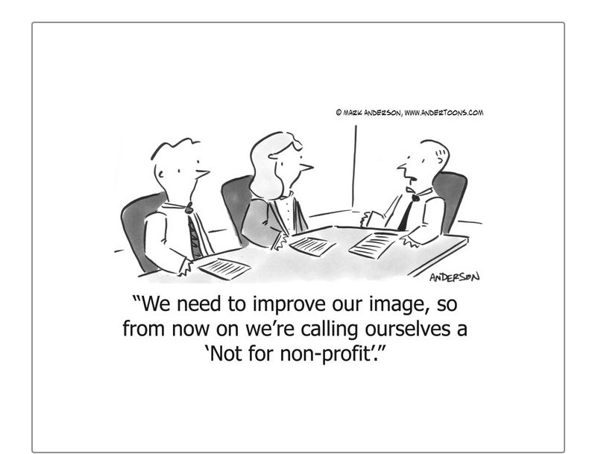

Slide 20

Governance

Slide 21
Governance
Nonprofit governance simply means how the nonprofit is administered.
The key players in a nonprofit organization are
  the directors,
  officers,
  committees,
  members,
  executive director,
  staff
  volunteers,
  any existing advisory boards or friends’ groups.
Each plays an important role in carrying out a nonprofit corporation’s mission.
In the eyes of the law, a corporation is a legal entity.
It is separate and distinct from the people who run it.
The corporation can enter into contracts, be sued, and perform other powers permitted by state law. These activities are carried out exclusively through the actions of the corporation’s board of directors or designee.

Slide 22

Accounting 101

Slide 23

Accounting Basics and Financial Statements

Slide 24
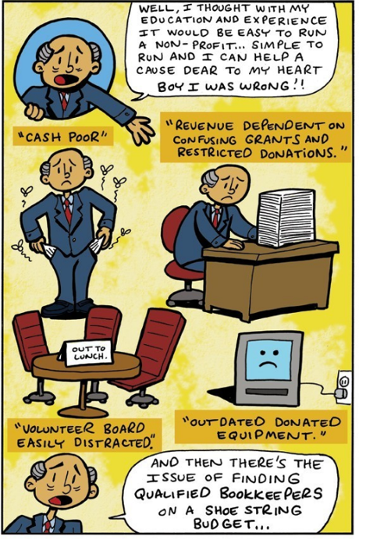

Slide 25
What is Accounting
Accounting allows organizations to identify how much money is coming in and being spent.
Without accounting there is no way to accurately predict cash flows, raise money for projects, or know if you can afford to purchase equipment or hire new staff.
Good accounting also allows for grant applications to be more accurate in requesting funding for projects.
The end product of accounting allows the user to generate reports to show the organization's monetary transactions and net worth.

Slide 26
Bookkeeping vs Accounting
Bookkeeping is the upkeep of everyday financial activities
Inputting data
Recording one side of transactions
Processing payroll
Allocating expenses
Writing checks
Making deposits
Accounting is the process of compiling reports and analyzing key information to inform strategic decisions.
Reviewing accounts
Understanding the purpose behind decisions
Preparing reports
Preparing for an audit
Filing your Form 990
Reconciling accounts
Ensuring GAAP standards are met

Slide 27
GAAP Generally Accepted Accounting Principles
GAAP is an acronym for Generally Accepted Accounting Principles. These principles constitute preferred accounting treatment.
Generally accepted accounting principles (GAAP) refer to a common set of accounting rules, standards, and procedures issued by the Financial Accounting Standards Board (FASB).
Public companies in the U.S. must follow GAAP when their accountants compile their financial statements
GAAP rules for nonprofits are intended to create transparency for donors, including grant-makers, as well as helping the government monitor whether an organization should retain its tax-exempt status.

Slide 28
More Guidelines
In addition to general GAAP principles, the rules that apply only to nonprofits include:
Labeling net assets:
  Net assets should be labeled according to whether they are donor restricted or without donor restrictions.
  The donor restrictions can be imposed by the terms of a grant or other document received from the donor.
Describing cash flow:
  Nonprofits must provide qualitative information that describes how they manage their liquid resources to meet everyday expenses.
  Nonprofits must show any limitations or restrictions that impact their cash flow.

Slide 29
More Guidelines
Investments:
  Nonprofits should be aware of any management fees related to their investments, as they do not need to report these separately.
  Nonprofits are required to report investment income net of related external and internal expenses.
Contributions:
  closely monitor and record all contributions, including amounts received from individuals, corporations, or other nonprofits, in compliance with GAAP.
  must record promises to give future donations as pledges receivable when you receive the pledge, rather than when your nonprofit receives the actual donation.

Slide 30
More Guidelines
Restricted Funds?
  Nonprofits receive two types of funds: restricted and unrestricted.
  Restricted funds are meant for a specific purpose of the donor’s choosing.
    These funds must be used for that purpose and that purpose only. Failure to do so can result in litigation and even the loss of nonprofit status.
  Unrestricted funds for any purpose.
    They often help organizations with administrative expenses, such as payroll and rent. Restricted funds are frequently not endowed to cover these costs, so unrestricted donations can be a welcome departure from that level of oversight.

Slide 31
Cash Basis vs. Accrual Basis
Cash Basis
Revenues and expenses are not recognized until money is exchanged.
Accrual Basis
Revenues and expenses are recognized when an obligation is made
The specific basis used to create a set of financial statements will be disclosed either on the face of the statement itself or in the footnotes to the financial statements
Notes:
The core underlying principle that governs how to interpret a set of financial statement is the basis on how they are prepared. Cash Basis or accrual basis. Cash basis is how most of us think of our personal finances – we get "revenue" when we receive a paycheck or get interest credited to our bank account. And we have expenses when we pay for groceries, or gas etc. However some organization will use the accrual basis of accounting. They recognize income when the issue an invoice for services or expenses when they get a bill. In other words they don't wait for the money to come in or go out. Refer to note on bottom of slide.

Slide 32
Cash Basis
Focused on the inflows and outflows of cash.
Much like your personal finances,
  revenue when a deposit is made
  expense when a check is cut
Little regard to when the revenue is actually earned, or the expense is actually incurred
Cash flows.

Slide 33
Accrual Basis
Focuses on when revenue are actually earned and when expenses are actually incurred.
  For example,
    Purchase of office supplies in the month of April on a credit card and pay for the purchase in May when the credit card bill is paid.
    Under the accrual method of accounting the expense for supplies is recorded in April.
Allows for better budgeting and planning
GAAP also require the use of the accrual method of accounting.
If wish to have an audit done under GAAP should use the accrual method of accounting.

Slide 34
Nonprofit accounting
Nonprofit accounting focuses on the accountability aspect of finances.
Nonprofit’s donors have the right to set restrictions on the donations they contribute to your organization and grant funders want to make sure their funds are spent on the agreed-upon programs.
These restrictions mean that you have to ensure their funds are spent in a way that the supporters approve of.

Slide 35
Nondistribution constraint
Another aspect of nonprofit accounting that helps organizations stay accountable to their finances is the nondistribution constraint.
This is a vital aspect of accounting that helps define nonprofits. Unlike for-profits, nonprofits are required not to distribute their net earnings to the leaders at the organization.
For example, if The Good Dog Animal Shelter found an extra $10,000 in their budget, they wouldn’t be able to distribute these funds to the executives and board members. That additional funding needs to be reinvested in the mission.

Slide 36
Internal Controls
Financial processes and procedures that enable the organization to safeguard its assets.
Proper internal controls are essential for all organizations.
Critical to the implementation of these controls is an appropriate level of segregation of duties.
Generally, management establishes the system of controls.

Slide 37
Internal Controls
The most effective procedures are those that have the greatest segregation of duties.
  The more people involved in the process, the less likely it is that an error or defalcation will occur.
    For example,
      the person who writes the checks should not be the person signing the checks.
It is helpful to have an accounting manual detailing in writing the procedures to be followed.
  enables all involved to understand their role
  provides a mechanism for maintaining the procedures in the event there is a change in personnel or leadership.

Slide 38
Non-Profit Financial Statement Basics

Slide 39
Financial Statements
Statement of Activities = Income Statement = Profit (Loss)
Measures the revenues against the expenses ▫ Revenues – Expenses = Change in Net Assets = Profit (Loss)
Statement of Financial Position = Balance Sheet
Measures the assets against the liabilities and net assets ▫ Assets = Liabilities + Net Assets
Statement of Cash Flows
Measures the changes in cash
Notes:
This chart equates the for profit f/s to its non-profit equivalent. Notice that the purposes of the finical statement are the same - it just has a different name. Statement of activities, income statement and P&L are all measuring income less expenses. The NI or profit/loss of this statement will roll into the next one – the statement of financial position or the balance sheet, the the net assets or retained earnings section. This will help complete the basic accounting equation – assets =liabilities plus equity or net assets for a non-profit.

Slide 40
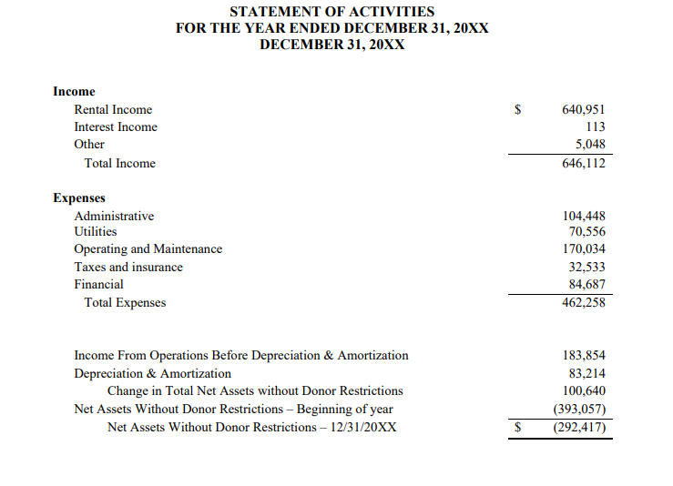
Statement of Activities
Similar to a for-profit income statement:
  Provides a snapshot of the activity for a period of time
Outlines how the organization generates income
  (service fees, donations, investment income, grants)
Shows how the organization spends its money (expenses)
Notes:
This example is based on the natural accounts – Rent income other income, admin, utilities and the others. Notice how the statement comes to a sub-total for Income from operations before depreciation and amortization? This is so that the reader can see the profitability of the organization before non-cash outlay items such as depreciation and amortization. It is entirely possible that an organization will show an overall loss of the organization, but be profitable at the operations level.

Slide 41
Expenses
According to GAAP, expenses are the cost of operations a company incurs to generate revenue.
Functional costs are related to specific departments within a nonprofit.
Operating expenses are the "keep the lights on" costs of the nonprofit world.
Administrative costs refer to money spent on a nonprofit organization’s management and operation.
Development costs are expenses that directly relate to achieving the goal of your nonprofit’s mission.

Slide 42
Statement of Activity
Revenue
  Membership Dues
  Program fees
  Grant support
  Fundraising income
  UBI Income
Expenses
  Rent
  Wages and Payroll taxes
  Utilities
  Postage
  Travel costs
  Event costs
  Legal/Accounting/Professional fees

Slide 43
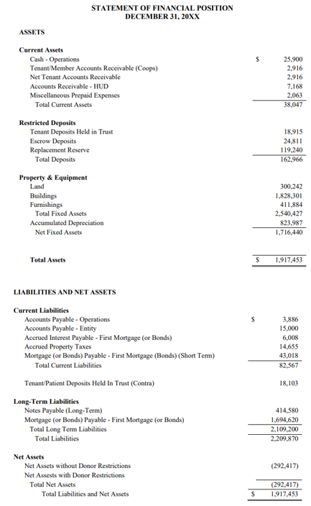
Statement of Financial Position
Similar to a for-profit balance sheet.
    Represents a snapshot at a point of time
    Assets = Liabilities + Net assets (equity)
Assets are what the organization owns or is owed
    examples are cash, accounts receivable, prepaid insurance, property
Liabilities are what the organization owes to others or has to pay in the future
    examples are accounts payable and loans
Net assets – accumulated earnings/losses
It is important to know if the organization has enough assets to pay liabilities in the both short/long term,
Notes:
Go through the basic structure – current assets - cash, receivables P&E, Current liabilities, long term liabilities, net assets

Slide 44
Statement of Financial Position
Assets
Cash and cash equivalents
  liquid assets, which may include Treasury bills and certificates of deposit.
Accounts receivables
  amount of money owed to the company by its customers for the sale of its product and service.
Inventory
  goods a company has on hand, which are intended to be sold as a course of business.
  inventory may include finished goods, work in progress, or raw materials on hand that have yet to be worked.
Prepaid expenses
  costs that have been paid in advance of when they are due.
  These expenses are recorded as an asset because their value of them has not yet been recognized;
  should the benefit not be recognized, the company would theoretically be due a refund.
Property, plant, and equipment
  capital assets owned by a company for its long-term benefit.
Investments
  assets held for speculative future growth.
  These aren't used in operations; they are simply held for capital appreciation.
Trademarks, patents, goodwill, and other intangible assets
  can't physically be touched but have future economic (and often long-term benefits) for the company.

Slide 45
Statement of Financial Position
Liabilities/Equity
Accounts payable
  the bills due as part of the normal course of operations of a business. This includes utility bills, rent invoices, and obligations to buy raw materials.
Wages payable
  payments due to staff for time worked.
Notes payable
  recorded debt instruments that record official debt agreements including the payment schedule and amount.
Dividends payable
  dividends that have been declared to be awarded to shareholders but have not yet been paid.
Long-term debt
  can include a variety of obligations including sinking bond funds, mortgages, or other loans that are due in their entirety in longer than one year.
  Note that the short-term portion of this debt is recorded as a current liability.
Shareholders' Equity
  company's total assets minus its total liabilities.
  Shareholders' equity (also known as stockholders' equity)
    represents the amount of money that would be returned to shareholders if all of the assets were liquidated and all of the company's debt was paid off.
Retained earnings are part of shareholders' equity and are the amount of net earnings that were not paid to shareholders as dividends.

Slide 46
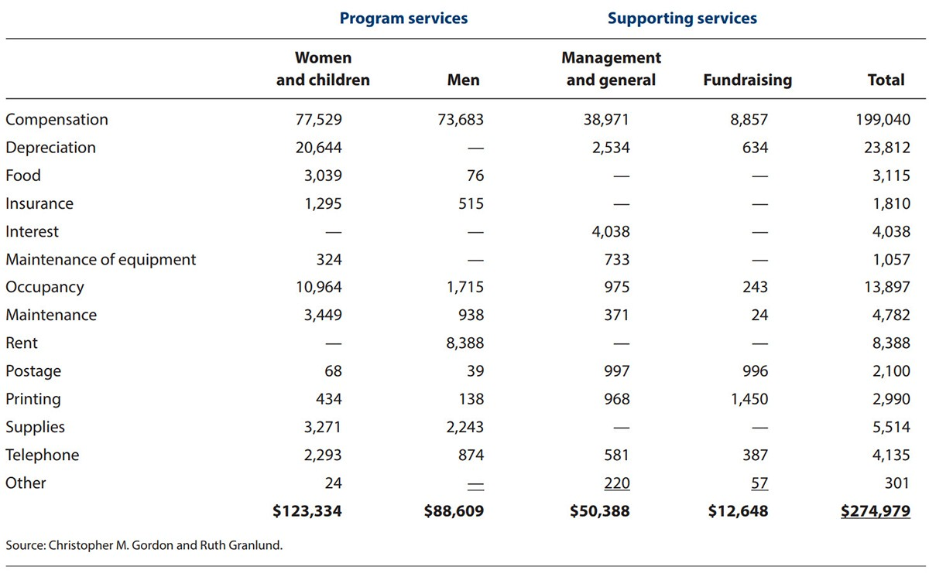
Statement of Functional Expenses
Not-for-Profit organizations are now required to provide an analysis of expenses by their natural classification (such as salaries, rent, and depreciation) as well as their functional classification (program, management and general, and fundraising) in one location.
Can be done on the face of the statement of activities, in a separate statement, or in the notes
Readers now have better visibility in program costs and where the dollars are going
Needs to show by Program and by natural account
Notes:
In addition to the statement of activities non-profits have been required to prepare a statement of functional activities. This statement should agree with the expenses section on the statement of activities. This provides greater detail in how the organization is spending its dollars and what portions are going to mission oriented costs and administrative overhead and fundraising

Slide 47
Statement of Functional Expenses
FASB Topic 958, Not-for-Profit Entities, requires all not-for-profit entities to present the relationship between functional expenses (such as major classes of program services and supporting activities) and natural expenses (such as salaries, rent, utilities, supplies, interest, and depreciation).
For financial statement users, this analysis provides an in-depth look at how nonprofits spend toward their missions.
For auditors and preparers, it necessitates consideration of the approach to the allocation and reporting of functional expenses.

Slide 48
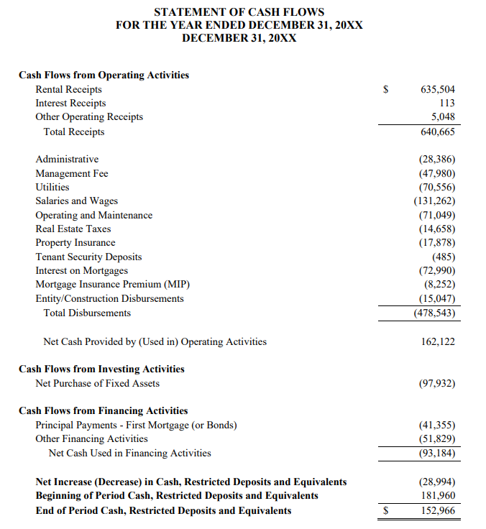
Statement of Cash Flow
Outlines a specific period of time, such as for the year ending
Is comprised of three sections:
  Cash generated/used in operating activities
  Cash generated/used in investing activities
  Cash generated/used in financing activities
Cash presented at end of period should equal the cash balance on the Statement of Financial Position
Notes:
Go through the statement of cash flows- this is a basically a combination of the statement of activities and the statement of financial position. The big take away here is that the cash balance at the bottom of the statement has to equal the cash balance on the statement of financial position

Slide 49
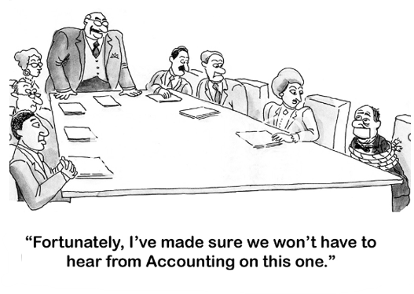

Slide 50

Revenue

Slide 51
Revenue
  Fees for goods and/or services
  Events
  Selling merchandise
  Sponsor ship (of an event)
  Cause marketing (partnership between a nonprofit and a for-profit business for mutual benefit)
  Peer to Peer fundraising
  Crowdfunding
  Individual donations
  Major gifts
  Bequests
  Corporate contributions
  Foundation grants
  Government grants and contracts
  Interest from investments
  Loans/program-related investments (PRIs)
  Tax revenue
  Membership dues and fees

Slide 52
Diversify Nonprofit Revenue Streams
creates security and stability for your organization.
help nonprofit stay flexible, adaptable, and resilient in times of risk and uncertainty.
helps expand your network—lead to more donors

Slide 53
Steps to Diversify Revenue
1. Evaluate your current streams of revenue
  How is your organization currently bringing in revenue?
  What’s working and what isn’t?
  What are some things your team is particularly good at and what are some gaps you’d like to fill?
2. Identify opportunities for new revenue streams
  What’s something you already have the means to implement but haven’t tried yet?
  What’s something you think will work well but need more time to build out?
  What are other nonprofits doing?
3. Create a plan of action
  Start small and set realistic expectations about what you can achieve and how long it will take.

Slide 54
Steps to Diversify Revenue
4. Test your assumptions
  Not every revenue stream you plan to implement will work for your organization, so before going all in, find a way to test your plan with minimum effort, time, and money spent.
5. Continue to evaluate your revenue streams
  Even after implementation, there’s no guarantee that a revenue stream will remain successful, so make continuously analyze the results of your efforts.
  If a revenue stream isn’t worth the work it requires, don’t hesitate to redirect efforts somewhere else

Slide 55
Tips for Increasing Revenue Streams for Nonprofit Organizations
1. Continue learning
  There was a time when revenue streams like crowdfunding didn’t even exist, so keep your eyes peeled for new trends and best practices you can try.
  Look to other nonprofits, as well as for-profit businesses — there’s a lot you learn from other industries!
2. Report on everything
  Keep track of as much data as possible — this will help you analyze your efforts and decide whether or not a new revenue stream is working.
3. Keep your messaging consistent across all revenue streams
  Clearly communicating your mission and your needs to prospective donors and partners can result in revenue streams crossing into one another.
  An individual donor could become a major donor; their company could get involved and become a corporate donor; they could then take interest in your upcoming event and become a sponsor, and so on.
4. Stay flexible
  Even if the majority of your revenue came from one revenue stream this year, don’t expect that to be the case next year.
  Grants could get cut, a sponsor’s priorities may shift, a global pandemic could hit and cancel all events. Always be ready to shift gears and try something else.

Slide 56
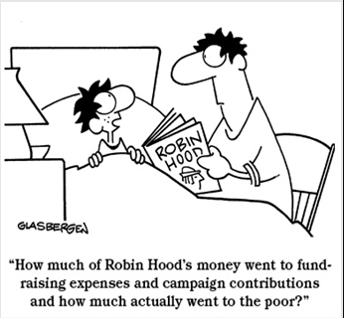

Slide 57
Budgeting

Slide 58
Nonprofit Budget
A nonprofit’s budget is the document that individuals in the organization are more likely to be familiar with.
This document is created by the leadership or finance team using information from the development team and historic spending habits from your organization.
Is the planning document used to predict expenses and allocate resources for your organization.
It details both the costs that your organization will incur as well as the revenue you expect to receive over a set period of time, usually a year.

Slide 59
Budgeting
When starting a budget cycle, the organization should:
  Analyze the most recent years financial activity
  Create a budget preparation checklist that includes a timeline

Slide 60
Budgeting
Five tips for budgeting revenue:
  1. Be realistic
  2. Have a contingency plan
  3. Spend appropriate time and effort on budgeting revenue
  4. Involve the appropriate individuals
  5. Look at each revenue source separately

Slide 61
Budgeting
Five (more) tips for budgeting expenses:
1. Start with personnel expenses first
2. Involve the appropriate individuals
3. Start with historical data and adjust for known and expected changes
4. Be reasonable in the expenses your business can incur
5. Make sure all cost drivers are recognized

Slide 62
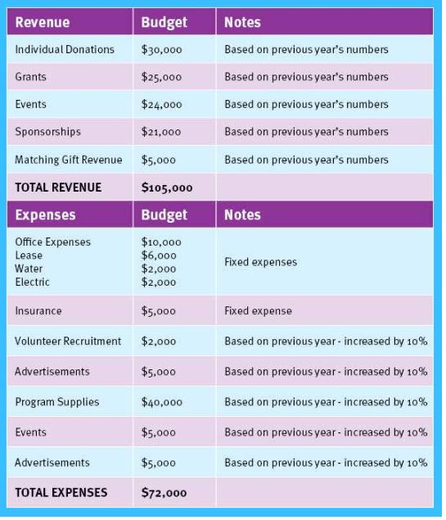

Slide 63


Slide 64
Ratios

Slide 65
Ratios
A wealth of information that can be obtained through ratios.
Ratios can reveal key information about an organization’s performance and financial wellness
  to senior management
  the board of directors,
  donors, grantors,
  the general public.
Ratios can vary significantly between nonprofit organizations based on their sector, revenue streams, timing of expenses, and overall financial health, when taken in context, the use of ratios can be a valuable tool when comparing:
  Organizations of similar size and age, that are located in the same area or similar locales, and that have similar missions or programs.
  When tracking an individual nonprofit’s progress over time.
Notes:
We've already briefly touched on ratios, and their usefulness. the following pages highlight some common ratios, expected targets, definitions and calculations.

Slide 66
Ratio | Measures | Calculation | Suggested Minimum
Current Ratio | Organizational financial health and vitality based on an ability to pay short-term financial obligations with available assets. | Current assets divided by current liabilities | 1.0 – 2.0 (to maintain a level of safety)
Quick Ratio | How well an organization can meet its short-term financial obligations. This ratio is often used by banks and other creditors in making lending decisions. | Current assets excluding any inventory and prepaid expenses divided by current liabilities | 1.0
Operating Reserve | Whether there are sufficient resources to support an organization and maintain its current operations and programming without having to borrow capital, assuming no additional revenue is generated. | Operating reserves or expendable net assets divided by annual expenses | 25%
Notes:
These are a few general organization level ratios

Slide 67
Ratio | Measures | Calculation | Suggested Minimum
Operating Margin | How effective an organization is at generating a surplus which can be used later if needed. This ratio may be helpful in forecasting. | Net results of operations (revenues less expenses) divided by operating revenues | 25%
Program Efficiency | How effective funds are used for the programs of an organization in fulfilling its mission. | Program costs excluding any special projects and pass-through costs divided by total expenses | Varies, however some guidance suggests a minimum of 6.0
Fundraising Efficiency | How effective fundraising activities are based on the expenses required to raise contribution and event revenue. | Contribution and/or event revenue divided by fundraising expenses | Varies, however some guidance suggests a minimum of 4.0
Notes:
These represent for detailed ratios on organization performance

Slide 68
Ratio | What is Measures | Calculation
Program Expense Ratio | Percentage of expenses spent on core mission | Program Services Expenses/Total Expenses
Administrative Expense Ratio | Percentage of expenses allocated to administrative costs | Administrative Expenses/Total Expenses
Governance Reliance Ratio | Reliance on governmental funding | Government Grants and Contributions/Total Revenue
Fundraising Efficiency Ratio | Amount of revenue generated that is spent on fundraising | Total Contributions/Fundraising Expenses
Current Ratio | Overall Liquidity | Current Assets/Current Liabilities
Cash Reserves Ratio | Adequacy of resources available to support mission | Unrestricted Cash and Liquid Investments/ Average Monthly Expenses (less Depreciation and Other Noncash Expenses)
Account Receivable Turnover Ratio | Trends in aging of accounts receivable | Net Sales/Average Accounts Receivable
Leverage Margin | Reliance on Debt | Total Liabilities/Total Assets
Net Margin Ratio | Ability to operate at a surplus | Total Revenues less Total Expenses/Total Revenues
Notes:
And finally some detailed ratios for specific purposes

Slide 69
Best Practices

Slide 70
Audit
An audit for nonprofit organization involves examining the organization's financial records to make sure they are complying with the requirements of a tax-exempt entity.
If the auditor finds that these requirements are not being met, the organization will most likely lose its nonprofit status.

Slide 71
Audit Facts
An independent audit is not required of every nonprofit organization
Federal Funding (directly or indirect)
State Funding
Private Foundation funding requirement
State requirements

Slide 72
Best Practices for Nonprofit Accounting
Conduct regular audits.
Not only is a financial audit NOT a bad thing, it can actually be a very good thing.
Meant to ensure the accuracy of the organization’s financials, as well as the financial health of the organization.
Publication of the results aid in financial transparency with current and future donors.
Provide insight into the various opportunities the organization has for financial stability and recording improvements.
Addressing these opportunities for improvement now helps keep financial data secure and well-reported in the future.

Slide 73
Best Practices for Nonprofit Accounting
Don’t overthink overhead expenses.
  Overhead includes those expenses that cover administrative costs, market their mission for fundraising, and pay for other internal expenses that help the organization grow.
  Essentially, overhead expenses are those that nonprofits use to pay for anything that isn’t a program directly related to the organization’s mission.
  To qualify as a “nonprofit,” organizations must meet certain IRS requirements. If they fail to maintain a certain percentage of revenue spent on programs, they lose their nonprofit status,

Slide 74
Best Practices for Nonprofit Accounting
Reference your budget frequently.
Should check in with your budget monthly,
Comparing and evaluating budgeted revenue and expenses against actual revenue and expenses.
This will ensure that your organization is staying on track to achieve your goals.

Slide 75
Best Practices for Nonprofit Accounting
Establish concrete internal controls.
Can limit cases of fraud,
Aid in catching errors.
There should still be a “checks and balances” system in place.
Small nonprofits especially struggle with implementing internal controls, but there are some specific guidelines you can follow such as:
  Share financial duties. For instance, if your bookkeeper records all incoming revenue for your organization, someone else should be the one to approve write-offs. This creates a system of checks and balances between roles at the organization.
  Instill security policies. Nonprofit cybersecurity can easily become a major risk to organizations, especially when you handle sensitive transactional information. Implement specific policies at your organization for the handling of this data.
  Take inventory of fixed assets. Some items are easily taken home from the office and forgotten about. Take regular inventory of the computers, cell phones, and other items that you allow your organization’s staff members to work with.
  Internal controls don’t mean that you don’t trust your organization’s staff members. It really helps to catch any mistakes and prevent inadvertent wrongdoing.

Slide 76
Best Practices for Nonprofit Accounting
To Hire or Outsource for Nonprofit Accounting
Roll the responsibilities up under an executive.
Hire a full-time accountant to join the team.
Outsource your accounting needs to an expert firm.

Slide 77
Your Role in Financial Oversight
Overall stewardship of the organization
Ensure that resources are used to accomplish the mission
Ensure financial health and that contributions are used in accordance with donor intent
Review financial statements
Compare financial statements to budget
Engage independent auditor, if necessary
Evaluate need for insurance:
  Director & Officers
  Error and Omissions
  Cyber
Notes:
If you sit on the Board of a non-profit you have several responsibilities – Fund Raiser/Evangelist/Advisor. But there are some specific responsibilities with regard to finances that you should be aware of. Specifically, are the donations and other sources of revenue being used in accordance with the donors intentions, either expressly ( a restricted donation) or generally (unrestricted donation that is used for the general mission of the organization). You also need to review the financial statements and budget to make sure the org is on track. In addition, you should make sure the org is adequately insured for D&O, E&A and cyber risks
So what are these financial statements anyway?

Slide 78
Items to Look for on the Statement of Activity
Contributions
Are the actual contributions consistent with the budget?
What is the trend of the last three years of contributions?
Investment Income -
What is the return on investments assets?
Is the return consistent with the market performance for similar investments?
If not, further information should be obtained to ensure effective management of the organization’s funds.
Administrative expenses -
Is the cost structure in line with the budget?
How do the administrative expenses compare with prior years?
Does the statement clearly communicate the activities of the organization over the period?
Notes:
While overall and operating performance of the organization is a good indicator of how the non-profit is performing, there are other items to look for. If there is budget information available and a comparison to prior periods (years or months) then you can perform further analysis to determine how the org is doing. Such as trending of contributions and other revenue sources. Is the org relying more now on individual donations as opposed to corporate grants in the past. What risks does this highlight? Are the investments underperforming the market? Have admin expenses gotten out of control?

Slide 79
Items to Look for on the Statement of Cash Flows
Cash Flows from Operations
Did the organization generate positive cash from its operations?
If not, is it a one-time issue or is a trend starting to develop?
Cash Flows from Investments
Was the purchase and redemption of investments consistent with the organization's investment policy and strategy?
Was there a significant redemption that was not reinvested?
Cash Flows from Financing
Does the organization hold debt?
Are debt payments consistent with budget and supportable going forward with the current cash management strategy?
Notes:
Analyzing this statement can yield some insights into the short and long term strengths and weakness of the organization- Is the org using investments to fund operations, are ther enough inflows of cash (donations, grants and other sources to cover the basic operations. Is the org supplementing operating cash with debt and is this a long or short term issue.

Slide 80
Additional Information to Consider
Footnotes to the Financial Statements - Footnotes to the financial statements refer to additional information that helps explain how an organization arrived at its financial statement figures. They also help to explain any irregularities or perceived inconsistencies in year-to-year account methodologies.
Annual Report - An annual report is a document that non-profits compile and release every year. It's designed to highlight the organization's major accomplishments, inspire readers about the organization's mission, build trust, and thank donors for their support.
Financial Ratios - Financial ratios offer a way to evaluate the organization's performance and compare it with similar organizations it itself. Ratios measure the relationship between two or more components of financial statements. They are used most effectively when results over several periods are compared.
Notes:
In addition to the basic set of financial statements, there are other sources of information that can provide more information to support the financial statements, inform the reader on the details of the programs of the organization and giev deeper insight into the performance of the organization. The foot notes to the FS are very important to read if they are present. Many smaller non-profits are not required to have an audit or review of their FS and therefor there may not be notes. AS we mentioned earlier, the basis of how the FS are prepared will be noted at a minimum. However if notes are present they can inform you of items that the FS don't usually show – Aging of receivables and terms of debt are a couple.
The annual report will usually show a set of condensed FS but will also go in to greater detail regarding the mission of the organization and its accomplishments. This will give a perspective of what they are actually using the funds for.
Ratios can be very useful in determining the organization performance to other similar organizations or to itself over a period of time. A good exapmple of this would be what the administrative costs percentages would be for two similarly focused, similar sized non-profits.

Slide 81
Tax Filings

Slide 82
The 990-N form
Also known as the 990-N e-Postcard
For annual gross receipts are less than $50,000.
Or if gross receipts fluctuate year-to-year but average at $50,000 or less in the previous three years.
Short, eight question form that is submitted electronically with the IRS.
The 990-EZ form
May be filed for annual gross receipts are less than $200,000 and total assets less than $500,000.
If your organization does meet these requirements, have the option to file the full 990 form if you so choose.
Can be filed electronically or on paper
The 990 form
Is required for annual gross receipts are greater than or equal to $200,000; or total assets that are greater than or equal to $500,000.
Is more intensive and requires that you complete the entire twelve-page form.
Can be filed electronically or on paper
The 990-PF
Is required for all private foundations, regardless of financials and assets.
This form is like the regular 990 form.
Can be filed electronically or on paper
Forms
Notes:
While not necessarily a financial statement, the non-profit tax form, the 990 series, provides a significant amount of information for organizations with revenues greater than $50,000. Under that then they just file the 990-N with the IRS that really doesn't contain any information. However the 990_EZ, the regular 990 and the 990-PF can provide a lot of information on the programs, accomplishments, administrative cost, fun, raising costs etc. These tax forms basically create a statement of net assets and a statement of activities along with program revenue and expenses. Other information contained are the names of the Board members, specific disclosures regarding the activities of the organization, etc.

Slide 83
Due Dates for Filing
15th day of the 5th month after the conclusion of the nonprofit’s fiscal year.
For the majority of nonprofits, who operate on the calendar fiscal year, your tax forms are due on May 15th unless you’ve specifically requested an extension.
If for some reason, your nonprofit cannot make the deadline of May 15th (or your organization’s specific deadline) to file your nonprofit taxes,
  you have the option to extend your time by six months.
  can apply for this 990 deadline extension by filing a Form 8868.
  if approved, this moves the deadline to November 15th for nonprofit organizations using the calendar fiscal year.

Slide 84
What happens if my Form 990 is filed late?
Gross receipts are less than $1,000,000 for its tax year files its Form 990 after the due date (including any extensions),
and the organization doesn't provide reasonable cause for filing late,
the Internal Revenue Service will impose a penalty of $20 per day for each day the return is late.
  The maximum penalty is $10,000, or 5 percent of the organization's gross receipts, whichever is less.
The penalty increases to $100 per day, up to a maximum of $50,000, for an organization whose gross receipts exceed $1,000,000.
An organization that fails to file the required information return (Form 990, Form 990-EZ, or Form 990-PF) or e-Postcard (Form 990-N) for three consecutive tax years will automatically lose its tax-exempt status.
Penalties
Notes:
In addition to IRS penalties, states can administratively dissolve a non-profit if it fails to renew its registration. While this can be undone, it is time consuming and can be expensive if outside assistance from CPAs and/or attorneys is required.

Slide 85
State Annual Registration
Registration to solicit donations in a state the Non-Profit is not registered in registered in
Specific tax-exempt letter from the state the Non-Profit is registered in
REGISTRATIONS
Notes:
Additionally non-profits may be required to update their annual registration with their state of formation. Most states require that a non-profit register with them if the non-profit is going to directly solicit donations in that state and most states will require the non-profit to get a letter from the state expressly denoting its non-profit statues

Slide 86

“I’d rather regret the things I’ve done than regret the things I haven’t d—oh crap, I forgot to file my 990!”
Lucille Ball

Slide 87
APPENDIX

Slide 88
Definitions
Cash Position - Is adequate cash on hand (ie. available and not invested or subject to letters of credit or similar) to ensure both the day to day and long-term objectives of the organization can be met?
Accounts Receivable - Are there balances due from contributors and customers that have been outstanding for a significant amount of time?
Investments - Are the investments held in line with the organization’s investment policy? For example, if the organization’s investment policy includes an ethical investing provision, are any investments held that are not in line with those requirements?
Capital Assets - Are any of the organization’s capital assets fully amortized? This could suggest capital purchases will need to be budgeted for in the near future.
Liabilities - Are there roughly enough current assets (Cash, Accounts receivable, Short-term investments) to offset the current liabilities (Accounts payable, Accrued liabilities)?
Net Assets - Is the ending net asset position positive for the organization? If the organization uses the restricted fund method, is the ending net asset position positive for each fund?
GAAP

Slide 89
Definitions
GAAP Generally accepted accounting principles (GAAP) definition: A set of rules and guidelines developed by the accounting industry for companies to follow when reporting financial data. Following these rules is especially critical for all publicly traded companies..
Depreciation- accounting method used to allocate the cost of a tangible or physical asset over its useful life. Depreciation represents how much of an asset's value has been used.
Internal Controls accounting and auditing processes used in a company's finance department that ensure the integrity of financial reporting and regulatory compliance. Internal controls help companies to comply with laws and regulations,and prevent fraud.
Fixed expenses (FE): payments like rent that will happen in a regularly scheduled cadence.
Variable expenses (VE): expenses, like labor costs, that may change in a given time period.
Accrued expense (AE):an incurred expense that hasn’t been paid yet.

Slide 90
Definitions
Building reserve: Funds set aside to pay for facility upkeep, upgrades, unexpected repairs that exceed money available through the regular budget, and replacement of fixtures and facility systems. Also known as a replacement reserve. Typically, these are unrestricted, but board-designated funds.
Capital expenditure: Payment of money to acquire fixed assets, such as a building or equipment
Operation expenses (OE): business expenditures not directly associated with the production of goods or services—for example, advertising costs, property taxes or insurance expenditures.
Allowance for doubtful accounts: An amount reflecting the portion of the accounts receivable which the organization reasonably believes it may not collect. The amount is often an estimate based on experience or trends in the industry.

Slide 91
Non-Profit vs For Profit Comparative
Basis for comparison | Non-Profit organizations | For-Profit organizations
Purpose | To make profits for serving society | To make profits for one’s personal fulfillment or a return to the shareholders
Types of organizations | Corporations that include clubs, trusts, associations, etc. | A corporation, a partnership, LLC or a sole proprietorship
People that manage | Board of Directors, Executive management, trustees, and committees | Board of Directors, Company management, Business owners, sole proprietors or partners
Revenue source/Funding | Donations, subscriptions, grants, program revenue, etc. | Selling goods and services
Financial statements/accounts prepared | Statement of Financial Position Statement of Activities Statement of Cash Flows Change in Net Assets | Balance Sheet Profit/Loss Statement Statement of Cash Flows Statement of Owners' Equity
Profit transferred to | Capital fund account | Capital account
Audience | Sell the message about mission of the organization and the benefits to society | Sell a product or service and how it will positively impact the buyer
Leadership | Board of Directors who guide without direct financial ownership | Biard of Directors with a financial stake in company
Taxation | Not taxed | Taxed on profits
Staff | Paid employees and volunteers | Paid employees
Culture | More community-oriented, Address and solve problems that have little financial incentive | Focus on finances and business metrics. Innovation to increase long term profitability
Notes:
A this chart describes, you can identify the differences between non-profit and for profit organizations through several different criteria.
For some the differences are fairly significant such as purpose, revenue sources and culture. And other are somewhat similar - leadership, management and staff

Slide 92
Non-Profit Codes

Slide 93
Questions?

Slide 94
What Is The Difference Between “Public Charities” and “Foundations”?

Slide 95
What Is The Difference Between “Public Charities” and “Foundations”?
501(c)(3) organizations are divided into two main categories, “public charities” and “private foundations.”
Public charities are 501(c)(3) organizations that get their support from the general public, government.
Donations made to public charities are usually tax-deductible.
Private foundations conversely distribute money via grants to fulfill a public purpose.
Contributions to private foundations are normally tax-deductible.
Private foundations are also not allowed to engage in direct lobbying activities.

Slide 96
What kind of transactions would you have at your nonprofit?

Slide 97
What kind of transactions would you have at your nonprofit?
Nonprofit revenue sources include
  donations,
  program fees,
  sales income,
  membership dues,
  investment income
  proceeds from fundraising events.
Nonprofit expenses include:
  rent,
  salaries,
  travel,
  postage,
  financial services,
  fundraising expenses.

Slide 98
How much should a non profit spend on overhead?

Slide 99
How much should a non profit spend on overhead?
Whatever is necessary to advance the organization's mission.
Overhead costs are investments in necessary infrastructure including rent,
salaries computer equipment leaking roof etc.
Best gauge of an efficient non profit is its impact in the community

Slide 100
What does it mean to report expenses by function?

Slide 101
What does it mean to report expenses by function?
Reporting expenses by function means to classify and report expenses according to the type of activity for which the expenses were incurred.
Not-for-profit organizations classify and report expenses on their statement of activities according to the following functions:
  Each of its major programs
  Management and general
  Fund-raising
  Membership development
In addition, not-for-profit organizations report their expenses by their nature (natural classifications such as salaries, electricity, repairs, etc.)

Slide 102
What is the difference between a balance sheet of a nonprofit organization and a for-profit business?

Slide 103
What is the difference between a balance sheet of a nonprofit organization and a for-profit business?
A main difference between the NFP's statement of financial position and the for-profit corporation's balance sheet is the equity section:
The for-profit corporation's equity section has the heading Stockholders' Equity. Within this section are the paid-in capital amounts for the shares of stock issued, the amount of retained earnings, and possibly some other items.
The not-for-profit organization's equity section has the heading Net Assets. The reason for the use of Net Assets is the NFP does not have owners. Within the net assets section are the amount of net assets without donor restrictions and the amount of net assets with donor restrictions.

Slide 104
What are net assets?

Slide 105
What are net assets?
Net assets is defined as total assets minus total liabilities.
The net amount of its total assets minus total liabilities is actually reported as net assets in its statement of financial position.
The net assets section for the NFP organization is divided into two major classifications:
  net assets without donor restrictions
  net assets with donor restrictions

Slide 106
What is an endowment?

Slide 107
What is an endowment?
An amount of Assets owned by an organization that is invested with the intention to be held in perpetuity.
The income and increases in value of the investments are available as income for program use and organizational purposes.
Endowment funds received from a donor are Funds With Donor Restrictions and cannot be re-directed for other purposes.
Endowment funds that are created by internal policy, they are Board-designated, or Quasi-Endowment.
Endowments are subject to multiple accounting and legal rules.

Slide 108
How do you record in-kind donation in accounting?

Slide 109
How do you record in-kind donation in accounting?
Donations in-kind are recorded on the books at fair value.
Fair value is defined as “the price that would be received to sell an asset or paid to transfer a liability in an orderly transaction between market participants at the measurement date.
Record the fair market value of the donated items on the day that they were received (or pledged).
Classify the revenue as “in-kind revenue” or the appropriate revenue account.
Record the same fair market value to either an expense account (if the items will be used immediately) or an asset account (if the items will remain in inventory or are tangible assets, like furniture or equipment).

Slide 110
Do nonprofits have to track in-kind donations?

Slide 111
Do nonprofits have to track in-kind donations?
Yes.
The full Form 990, Form 990-EZ, and Form 990-PF all require your nonprofit to report your total revenue for the year, including the credit values of in-kind donations.
The IRS typically requires additional paperwork for a few types of in-kind donations: Items worth more than $25,000.

Slide 112
What information must be disclosed in the notes to the financial statements for NFP entities?

Slide 113
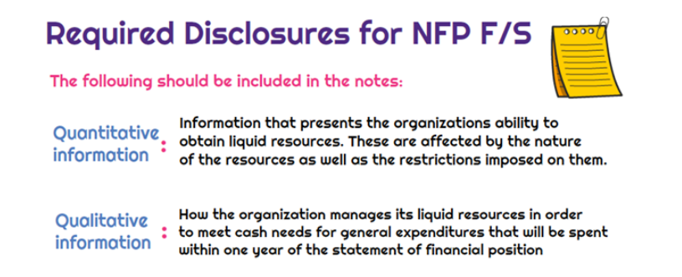
What information must be disclosed in the notes to the financial statements for NFP entities?
Not-for-profit organizations are required to disclose information that is relevant about the liquidity or the maturity of assets and liabilities. This will include restrictions and self-imposed limits on the use of specified items.
The notes to the financial statements for not-for-profit organizations should consist of both quantitative and qualitative information:

Slide 114
Should a depreciation expense be included in the calculation when looking at the percentage of administration expenses to total operating expenses with a nonprofit?

Slide 115
Should a depreciation expense be included in the calculation when looking at the percentage of administration expenses to total operating expenses with a nonprofit?
It is a good idea to allocate and include depreciation expense in program(s), admin and fundraising.
This helps show the cost of doing the work, as at some point equipment will have to be replaced and it is good to know which program is “using” it the most.
If an organization does an audit it will show depreciation as a part of your total expenses and allocate it across all your functional areas.

Slide 116
Why is Categorizing Expenses so Important?

Slide 117
Why is Categorizing Expenses so Important?
Categorizing your expenses can be confusing as there are gray areas where expenses could fit into more than one category.
The most important thing is to be consistent in how you assign expenses to categories.
And make lots of notes so later you can remember why you put certain numbers in certain places.

Slide 118
References
Form 1024
https://www.irs.gov/forms-pubs/about-form-1024
Form 990 https://www.irs.gov/forms-pubs/about-form-990
AICPA https://www.aicpa-cima.com
MSCPA https://www.mocpa.org

Slide 119
Free tools for nonprofits.
Google for Nonprofits: Google for Nonprofits provides free access to Google tools like Ad Grants, G Suite for Nonprofits, YouTube Nonprofit Program, and Google One Today.
Canva: Canva is a graphic design platform that allows nonprofits to create high-quality visuals for their social media posts, newsletters, and other communications.
Trello: Trello is a project management tool that allows nonprofits to manage their tasks and projects in a more organized way.
Asana: Asana is another project management tool that can help nonprofits to streamline their workflows and improve collaboration among team members.
Hootsuite: Hootsuite is a social media management tool that allows nonprofits to manage multiple social media accounts, schedule posts, and track their social media analytics.
Mailchimp: Mailchimp is an email marketing platform that allows nonprofits to send email campaigns to their supporters and track the success of their campaigns.
WordPress: WordPress is a content management system that allows nonprofits to create a website for their organization.
Zoom: Zoom is a video conferencing tool that can be used for virtual meetings, webinars, and events.
Slack: Slack is a communication tool that allows nonprofits to communicate with their team members in real-time.
SurveyMonkey: SurveyMonkey is an online survey tool that can be used to collect feedback from supporters and stakeholders.

Slide 120

Thank you for your dedication, vision and hard work!

Slide 121


Slide 122


Slide 123

Contact Information
Dan Sills
Linda A. Moder
O|MIGA, Inc
314.499.8249
www.o-miga.com

