Slide 1

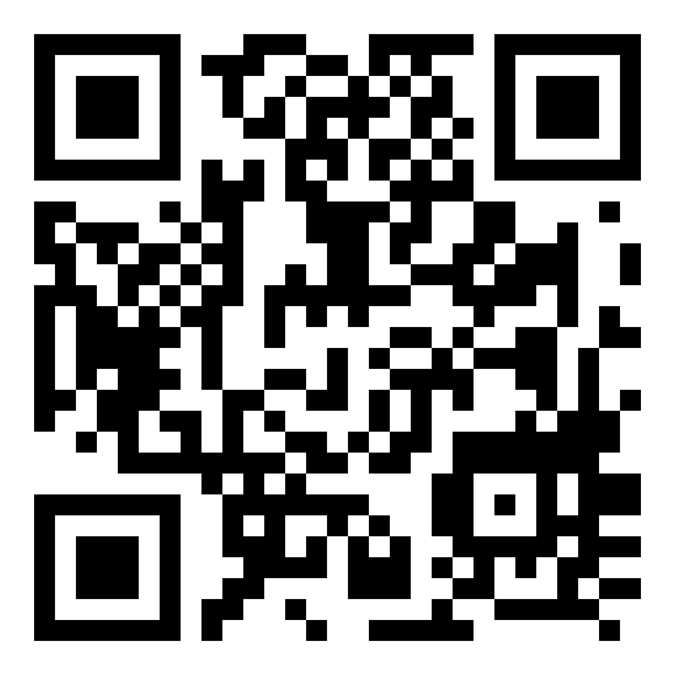
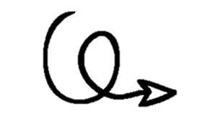
NonProfit 360
Session 1:Welcome, Introductions, the Nonprofit Lifecycle
Link to handouts and instructional resources…

Slide 2
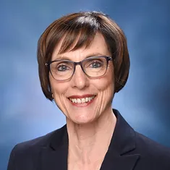
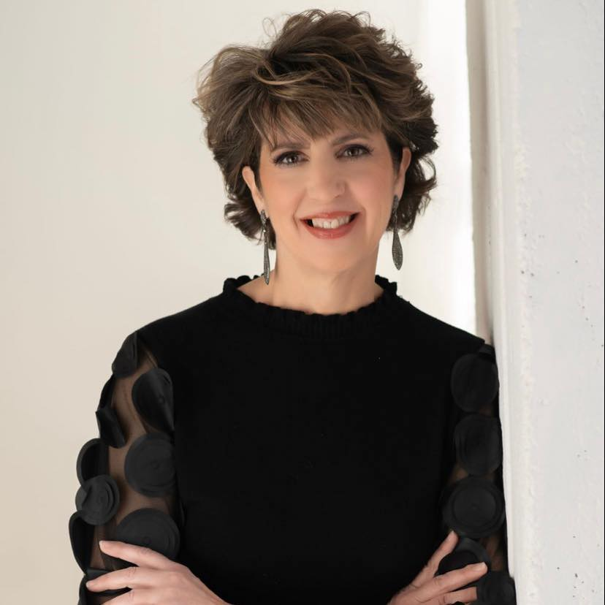


Introductions
Rachel Covington
Executive Director,
Community Value Alliance
Julie Turner, Ph.D.
Professor & Associate Director, Duree Center for Entrepreneurship
Lindenwood University
https://www.linkedin.com/in/rachel-covington-4b89a232/
https://www.linkedin.com/in/julie-maire-turner-ph-d-4923349/

Slide 3

Course Objectives:
2:00-2:30
Introductions / Icebreaker
2:30-2:45
Overview of the program goals and "cadence"
Participant's goals/expectations
Program expectations
2:45-3:00
The New Nonprofit Landscape: Opportunities, Trends, Threats
3:00-3:45
Introduction to the Nonprofit Lifecycle
3:45-4
Questions; Objectives for Week 2

Slide 4


Let’s get to know each other!

Slide 5
What to expect…
Capacity Areas
Week 1 Topic(s)
Logistics / Tempo
Cohorts / Roundtable

Slide 6

The New Nonprofit Landscape

Slide 7

Charitable nonprofits embody the best of America. They provide a way for people to work together for the common good, transforming shared beliefs and hopes into action. They give shape to our boldest dreams, highest ideals, and noblest causes.
America’s 1.3 million charitable nonprofits feed, heal, shelter, educate, inspire, enlighten, and nurture people of every age, gender, race, and socioeconomic status, from coast to coast, border to border, and beyond.
They foster civic engagement and leadership, drive economic growth, and strengthen the fabric of our communities. Every single day.

Slide 8
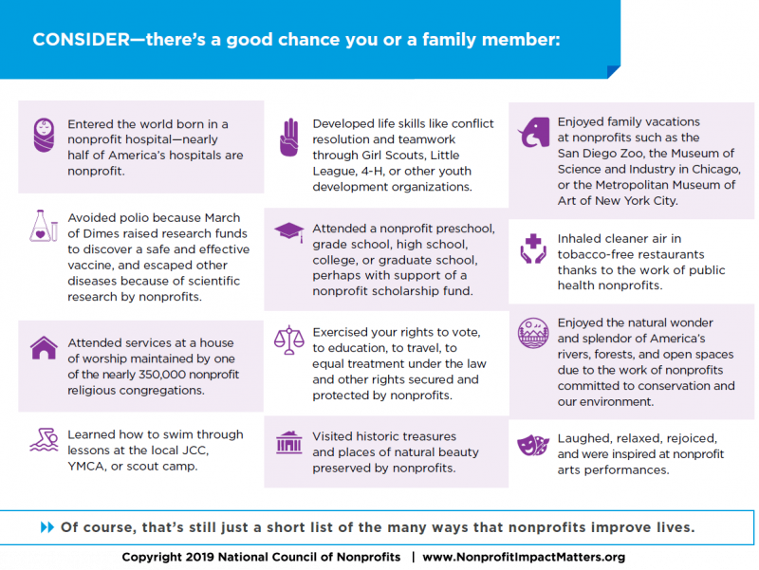

Slide 9

Underperformance
Toxic work environments
Lack of training
Urgent social needs; crises
Burnout
Lack of resources
Lack of time

Slide 10

What do YOU think will be the biggest challenges for NPOs over the next 25 years?
Increased demand for transparency
Growth and awareness
Mission metrics
New digital opportunities (i.e., virtual impact on what is “relational”)
Data analytics
Donor demographics (i.e.,aging)
Staffing & succession planning
Inclusion & access
Creative revenue sources (i.e., social entrepreneurship)

Slide 11

The Nonprofit Lifecycle & Organizational Readiness

Slide 14
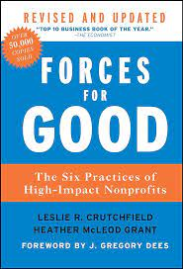
Fact or Fiction Trivia Game!

Slide 15




Our Sponsors:

Slide 16
Up Next: Next Session’s Objectives
TO DO: Bring back your completed 1) nonprofit lifecycle assessment; and 2) organizational readiness assessment
Review of lifecycle assessment;
Logic model basics

