Slide 1
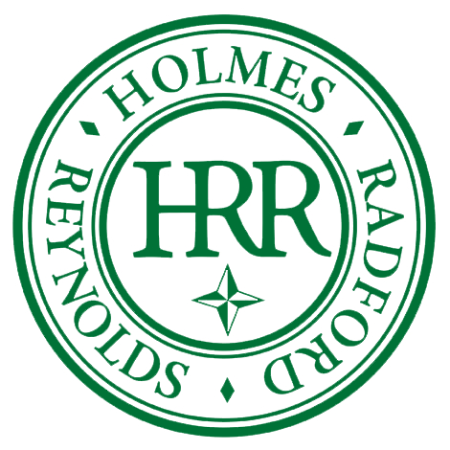
The case for Mergers and combinations
January 8, 2025
Presented by: dan reynolds, President Holmes, Radford & Reynolds, inc.

Slide 2
Introduction
Who is Holmes?
Based in St. Louis
30-year-old firm
Feasibility Studies, Campaign Management, Capacity Building, Strategic Planning, Mergers and Combinations
Notable Campaign Initiatives

Slide 3
State of the Sector
The nonprofit sector is experiencing a dynamically changing environment challenging most organizations and their missions in a variety of ways:
Raising more money during a time when funding resources and donors are changing
Finding a way to be unique among too many nonprofits providing the same or similar services
Executive Directors retiring and the difficulty of attracting a skilled workforce
Addressing legal issues and new legislation
Importance of financial management for the organization; program development and evaluation
Creating a compelling brand story.

Slide 4
The Case for Combination
The multiple challenges our community faces in this moment inspire all of us to be innovative, creative, and strategic to ensure the continuation of critical nonprofit missions for St. Louis.
Combining forces between Nonprofit Organizations may represent a unique opportunity to create a unified organization with an enhanced capacity to advance and sustain missions.
By leveraging each organization's strengths and joining forces, a merger / combination aims to provide a continuum of services, expand market share, reduce competition for resources, and strengthen the overall brand.
“Nonprofit mergers and acquisitions are often an effective way to deliver more and better services at lower cost.”
Stanford Social Innovation Review

Slide 5
Nonprofit Synergy Alliance
With collaboration among nonprofit leadership sure to be an important conversation going forward, the members of the Nonprofit Synergy Alliance have come together to be a single resource to help Executive Directors and their organization’s boards facilitate conversation and implement change.
The Nonprofit Synergy Alliance includes experienced leaders in the areas of fundraising, human resources, legal, accounting, program evaluation, strategic planning, board development, branding, and communications.
The goal of the Nonprofit Synergy Alliance is simple – to advance stronger, more effective, and more sustainable nonprofits who aim to increase their impact in St. Louis.

Slide 6
The Process
We follow the nationally regarded, best-practice model developed by Mission + Strategy Consulting to help nonprofits explore the possibilities of strategic formal partnerships and mergers.
Actions and Services include:
Partnership matching services and recommendations
Merger or partnership feasibility analysis, including:
  Financial assessment
  Mission alignment
  Cultural affinity
  Readiness
Confidentiality agreements
Case for Support
MOUs and term sheets
Due diligence
Legal documents
Integration and communication planning
Guiding and monitoring implementation

Slide 7
Toolkit and Path

Slide 8
Resources

Slide 9
Discussion
Thank you!
Dan Reynolds, President, Holmes, Radford & Avalon, Inc.
314-308-8038
dreynolds@holmesradford.com
www.holmesradford.com

