Slide 1

NonProfit 360
Fund Development
Presented by: Kathy and Brad Lambert, KBL Impact Partners

Slide 2

Course Objectives:
Understanding Your Costs
Creating a Fund Development Plan
Having Effective Donor Conversations
Mapping a World of Funding Opportunities

Slide 3
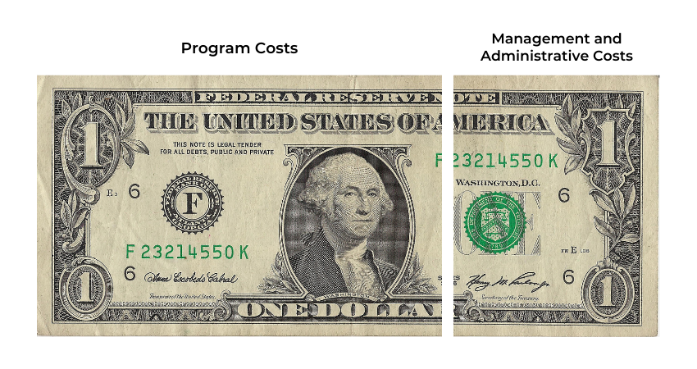
Full Costs of a Nonprofit
FULL COSTS INCLUDE ALL THESE ELEMENTS
M&A Costs
Marketing
Fundraising
Rent & Utilities
Accounting

Slide 4
Organizational Annual Budget
INCOME TOTAL PROGRAMS M&A
Events/Fundraising
Grants
Family Foundations
Corporate
Individual
Board
Other/Earned Income
Total | $0.00 | $0.00 | $0.00

Slide 5
Organizational Annual Budget
EXPENSES TOTAL PROGRAMS M&A
Salaries
Fringe
Accounting (Audit, Software, Payroll)
Advertising
Automobile
Bank Fees
Conferences and seminars
Meals
Contract services
Dues and subscriptions
Equipment Rental

Slide 6
Organizational Annual Budget
EXPENSES TOTAL PROGRAMS M&A
Fundraising
Gifts
Insurance
Maintenance
Office supplies
Postage
Printing
Rent
Repairs & Maintenance
Staff training
Tax and Licenses

Slide 7
Organizational Annual Budget
EXPENSES TOTAL PROGRAMS M&A
Technology
Telephone
Travel
Utilities
Total Expenses
Reserves
Total Expenses Plus Reserves

Slide 8
Matrix for Funding Source Planning
 | Money Expected | % of Probability (i.e., 50%) | Amount used for budget (i.e. percent of probability divided by money expected)
Example | $1000 | 50% | $500
Individuals
Memberships
Direct mail campaign
Events
Cultivating major donors
Planned giving
Volunteer opportunities
Board all gives
Other:

Slide 9
Matrix for Funding Source Planning
 | Money Expected | % of Probability (i.e., 50%) | Amount used for budget (i.e. percent of probability divided by money expected)
Example | $1000 | 50% | $500
Foundations
Large/National Foundations
Regional Foundations
Family and community foundations
Corporate-based foundations
Donor Advised Funds
Other:

Slide 10
Matrix for Funding Source Planning
 | Money Expected | % of Probability (i.e., 50%) | Amount used for budget (i.e. percent of probability divided by money expected)
Example | $1000 | 50% | $500
Corporate/Business
Corporate giving (grants) programs
In-kind gifts programs
Sponsorships
Retail
Other:
Other:

Slide 11
Matrix for Funding Source Planning
 | Money Expected | % of Probability (i.e., 50%) | Amount used for budget (i.e. percent of probability divided by money expected)
Example | $1000 | 50% | $500
Government
Federal Grants
State Grants
Sponsorships
Local Grants
Contracts
Federal Grants

Slide 12
Matrix for Funding Source Planning
 | Money Expected | % of Probability (i.e., 50%) | Amount used for budget (i.e. percent of probability divided by money expected)
Example | $1000 | 50% | $500
Other/Miscellaneous
Earned income (specify)
Religious institutions
United Way & other federated
Kiwanis, Lions, Professional groups
Labor Unions
Other:

Slide 13
Donor Conversations
INTENTION + MECHANISM = RESULT
? % + ? % = 100%

Slide 14
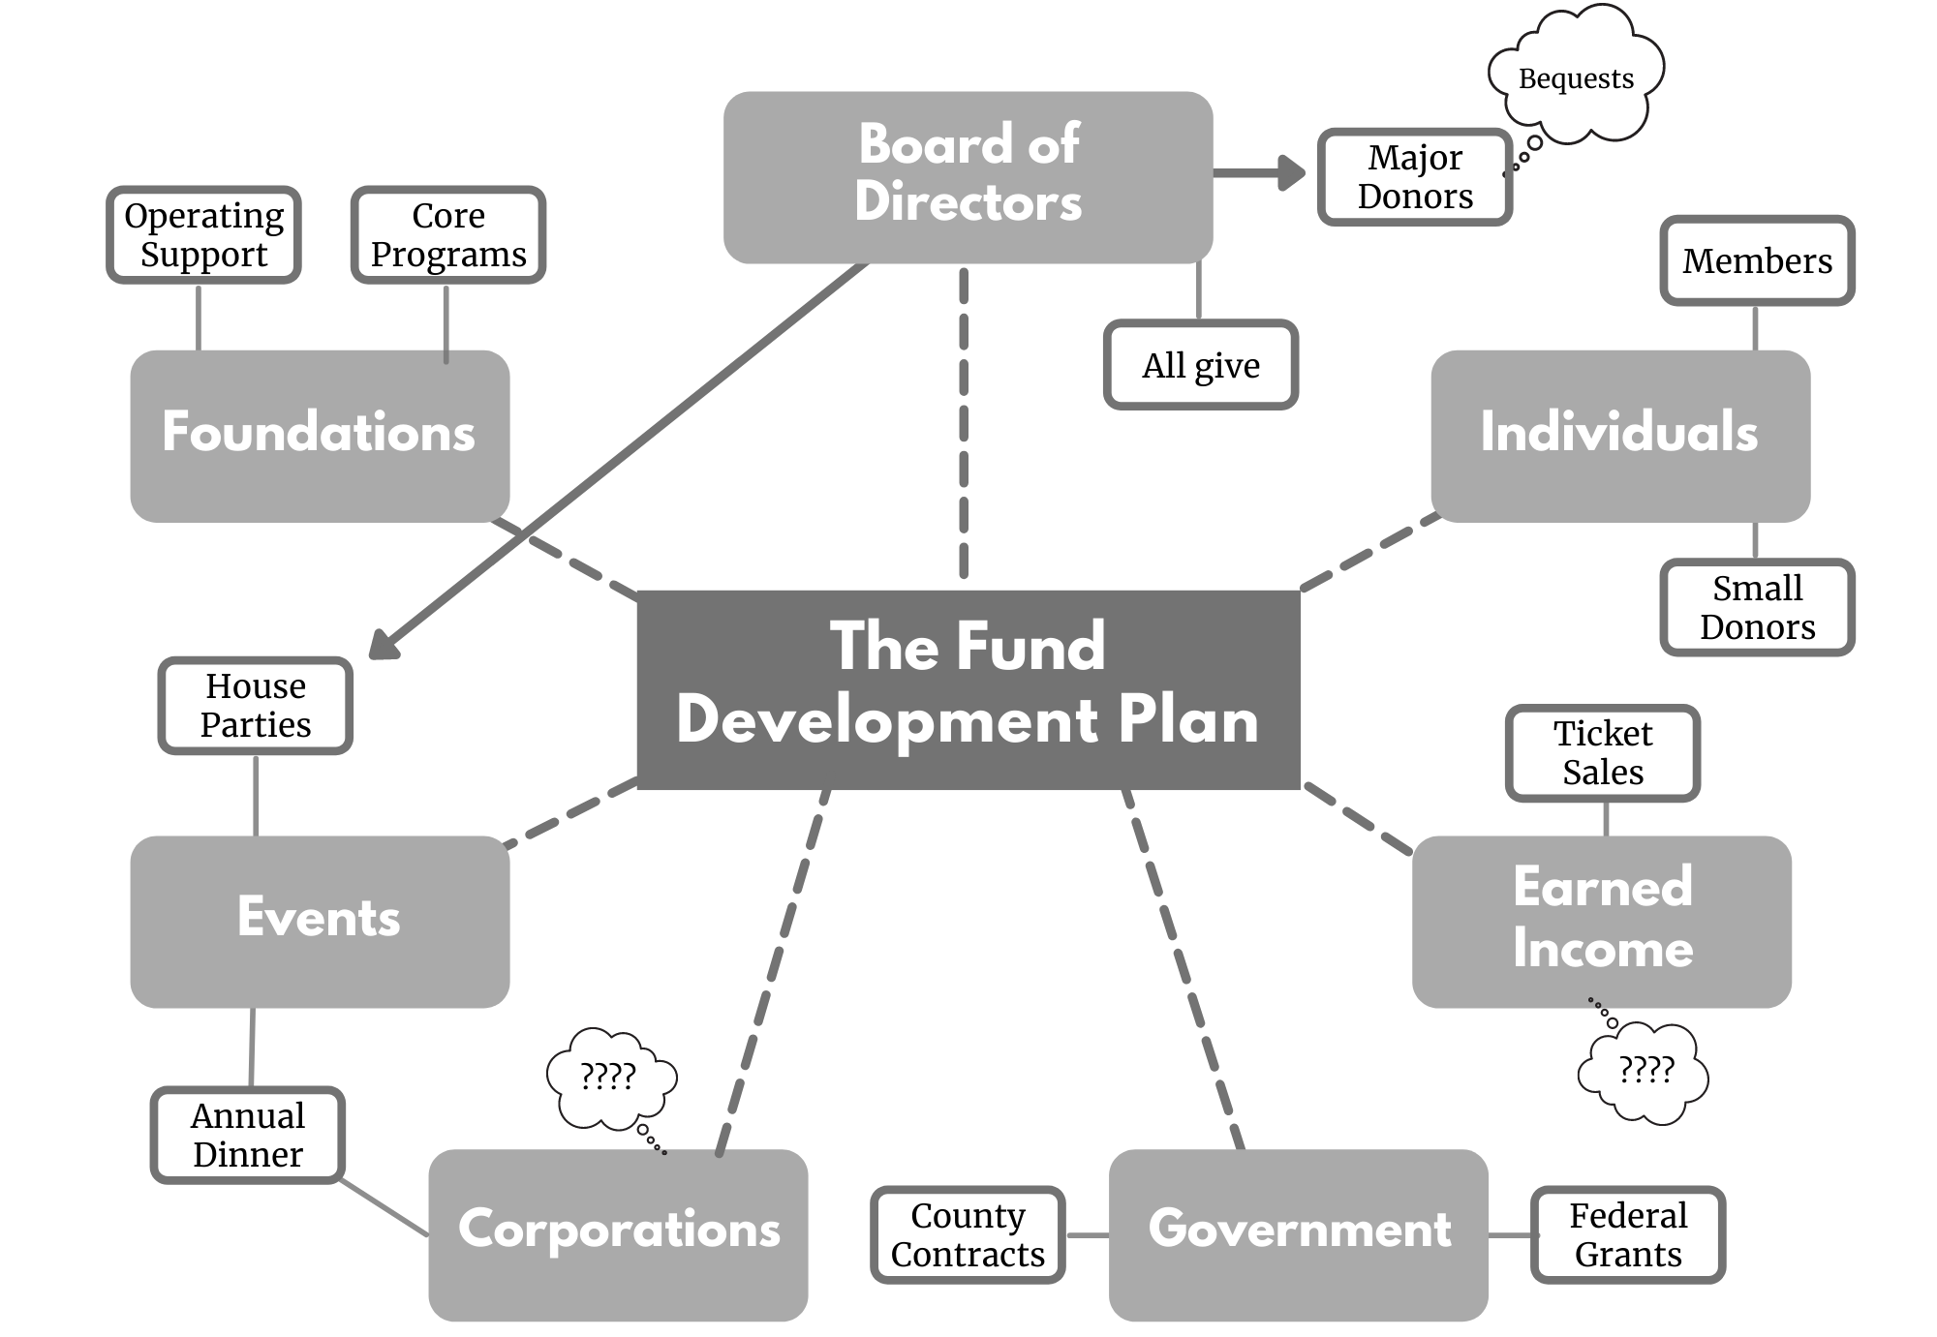
Mapping A World of Funding Opportunities

Slide 15
Presenter & Contact Information
Kathy Lambert
Kathy@kblimpactpartners.com
Brad Lambert
Brad@kblimpactpartners.com
www.kblimpactpartners.com

Slide 16
Up Next:
Next Session’s Objectives
Nonprofit Legal Process & Bank Fraud – November 6th

