Slide 1
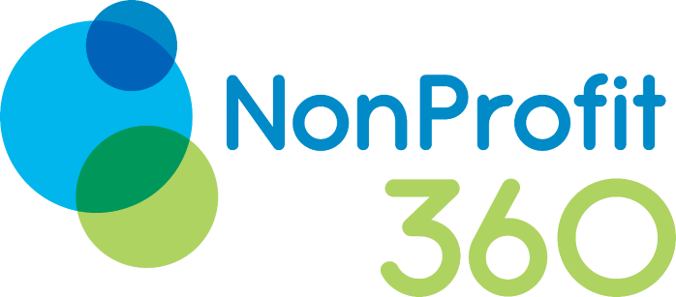
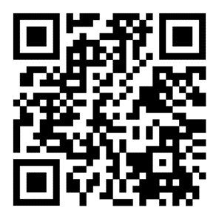
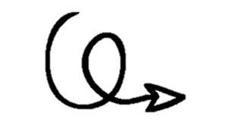
NonProfit 360
Session 2: The Nonprofit Lifecycle, Organizational Readiness, and Logic Model Basics
Link to handouts and instructional resources…

Slide 2
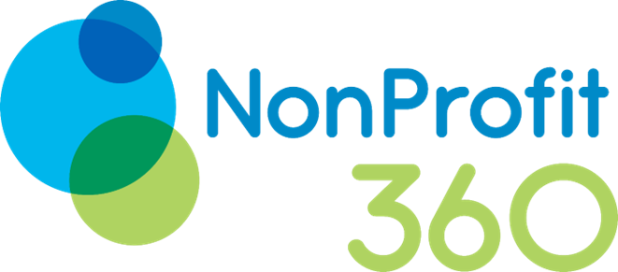
Agenda
Review of lifecycle assessment and organizational readiness assessments; and
Logic model basics

Slide 3

But first…
Let’s play “Name These Terms!”
Fridgescaping
Security Tray Aesthetic

Slide 4







Slide 5
The Nonprofit Lifecycle & Organizational Readiness

Slide 6

Activity:
Grab a picture card that you feel represents where your organization is now.
Now take a picture card that represents where you think you are headed.
Share with the group.

Slide 7
Discussion: Where did you land on 1) lifecycle assessment; and 2) organizational readiness?

Slide 11



Founding Stage
New leadership
Create legal entity
Establish policies
The founding leaders assemble the initial board and establish the nonprofit's mission and vision.
The nonprofit is incorporated and obtains 501(c)(3) tax exemption from the IRS.
The board adopts bylaws, conflict of interest policy, and other foundational policies.
The founding stage establishes the nonprofit through leadership, legal formation, and foundational policies.

Slide 13



Growth Stage
More employees hired to handle expansion
New strategic partnerships formed
New products or programs launched
Signing more contracts with partners
Expanding offerings to reach new audiences
Rapid hiring and onboarding process
The growth stage is characterized by expansion in staff, partnerships, and offerings to support rapid scaling.

Slide 15




Maturity Stage
Established leadership
Clear strategic plan
Diversified funding
Strong processes
The nonprofit has a stable executive team and board.
The nonprofit has a 3-5 year strategic plan that guides decision making.
The nonprofit has a mix of funding from individual donors, foundations, government grants, and earned income.
The nonprofit has standardized and documented processes for programs, operations, HR.
In the maturity stage, a nonprofit is stable, strategic, and has established operational processes.

Slide 16



Decline Stage
Founder burnout
Failure to innovate
Leadership vacuum
The nonprofit founder gets tired and lacks motivation to keep leading.
The nonprofit fails to adapt its programs and services to changing community needs.
Key leaders leave and there is no succession plan to replace them.
These factors can lead a nonprofit into decline if not addressed proactively.

Slide 18


Renewal Stage
Fundraising efforts
Reevaluate programs
New leadership
Host fundraising events and seek donations to increase revenue
Analyze existing programs and cut unsuccessful ones to reduce costs
Hire new executives with fresh ideas to set a new strategic vision
By renewing fundraising, programs, and leadership, declining nonprofits can get back on track for growth and impact.

Slide 22
Applying the Model
Identify the current lifecycle stage
  Assess organizational age, size, systems, and culture to determine current lifecycle stage.
Align strategies and structure
  Ensure strategies, staffing, and systems fit the lifecycle stage rather than mismatched models.
Plan for evolution
  Anticipate upcoming transitions and proactively adapt.
Manage leadership change
  Executive succession planning should align with lifecycle transitions.
Embrace lifecycles
  Lifecycles are normal and present opportunities for renewal and growth.

Slide 23
Time for a Scenario….
Refer to hand-out – “which-is-which” stage? What should be the priority for each situation?
  Idea
    This is the place for a feasibility study or a business plan to determine viability and start-up steps.
  Start-up
    This is the place for a business plan, with annual implementation plans, and a strong fundraising plan focused on implementation. Transitioning out of this phase requires a strategic plan to address growth, personnel and position descriptions, governance transition (from a working board to a governing board), and strong focus on fundraising to raise the money needed.
  Growth
    This phase requires a strategic plan that focuses on governance, capacity, development, and systems. To run this organization, a CEO must change their style and up their skill level. Cash flow can be a challenge, prompting the need for larger, multi-year grants or contracts.
  Maturity
    In the early part of this stage, mature groups need a strategic plan that focuses on managing the organization and deepening programs. In the later part, it needs to look at options or scenarios for changing up programs and integrating people, programs, and money. The board is governing, but they may also be moving toward a more limited sense of engagement, and feeling set in their ways.
  Decline
    This group needs an organizational assessment and a crisis plan, or recommendations for changes in leadership, board, and programs. Organizations in decline will need to recognize and address their problems, and then build a crisis plan for addressing the issues.
  Turnaround
    This phase often requires a CEO who is willing to do very tough things with the organization, which could mean replacing the existing chief executive with a new or interim leader. This CEO needs to work closely with the board, and follow a turnaround plan which will inevitably cause waves, disrupting the organization’s culture and people.
  Terminal
    This phase requires an organizational assessment to frame the options and make recommendations to the board, which might involve a “soft” or “hard” close. It is best to take action prior to a forced bankruptcy.

Slide 24


Slide 25

Logic Models
What, Why, and How?

Slide 26
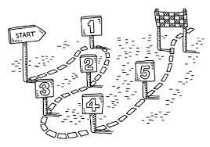

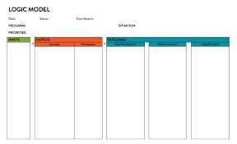
Notes:
A logic model is a visual representation of your nonprofit’s planned programming. It is a road map of how you and your team intend to achieve your desired outcomes using defined resources and strategies. Your nonprofit logic model also allows you to communicate your performance measurements specifically and clearly. With a single sheet, stakeholders and funders can see the initiatives, investments, enablers, duties performed by staff and volunteers, and other activities involved in developing your nonprofits as well as the immediate impact of each of them.
Here are four steps to keep in mind while designing your nonprofit’s logic model:
Identify your nonprofit’s priorities: Start by defining your organization’s mission, vision, values, and needs assessment. Think about your current challenges and note the overall impact you intend to have over a given period.
Assess your current inputs: Your nonprofit’s inputs are the resources you put into a program, campaign, or intervention. These can include business partnerships, in-kind contributions, technology, volunteers, and other assets.
Define your activities: Your nonprofit’s activities are the things you do to achieve your desired outcomes. These can include training, education, outreach, advocacy, and other initiatives.
Define your outcomes: Your nonprofit’s outcomes are the changes you expect to see as a result of your activities. These can include changes in behavior, knowledge, attitudes, and other factors.

Slide 27
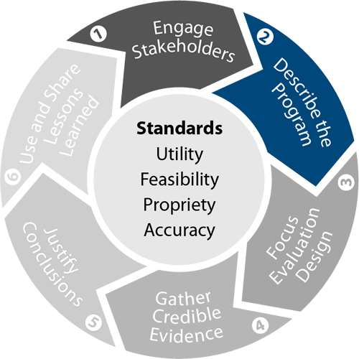
What is a logic model?
A logic model is a graphic depiction that presents the shared relationships among the resources, activities, outputs, and outcomes/impacts for your program.
It depicts the relationship between your program’s activities and its intended effects, in an implicit ‘if-then’ relationship among the program elements — if I do this activity, then I expect this outcome.
Among other things, a logic model helps clarify the boundary between ‘what’ the program is doing and ‘so what’—the changes that are intended to result from strong implementation of the “what.”
Logic models differ widely in format and level of detail. Here are some key terms used in logic models, although not all are employed in any given model:
Inputs: The resources needed to implement the activities
Activities: What the program and its staff do with those resources
Outputs: Tangible products, capacities, or deliverables that result from the activities
Outcomes: Changes that occur in other people or conditions because of the activities and outputs
Impacts: [Sometimes] The most distal/long-term outcomes
Moderators: Contextual factors that are out of control of the program but may help or hinder achievement of the outcomes

Slide 28
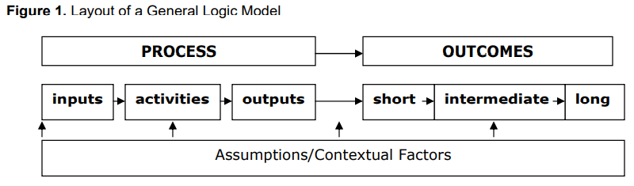
Why are logic models important?
The basic components of a good logic model are:
Displayed on one page.
Visually engaging.
Audience specific.
Appropriate in its level of detail.
Useful in clarifying program activities and expected outcomes.
Easy to relate to.
Reflective of the context in which the program operates.
Logic models increase the likelihood that program efforts will be successful because they:
Communicate the purpose of the program and expected results.
Describe the actions expected to lead to the desired results.
Become a reference point for everyone involved in the program.
Improve program staff expertise in planning, implementation, and evaluation.
Involve stakeholders, enhancing the likelihood of resource commitment.
Incorporate findings from other research and demonstration projects.
Identify potential obstacles to program operation so that staff can address them early on.

Slide 29
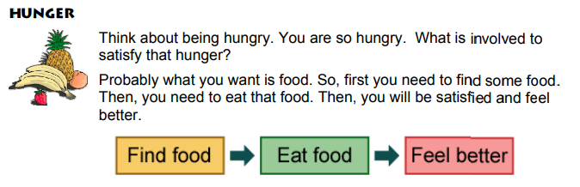
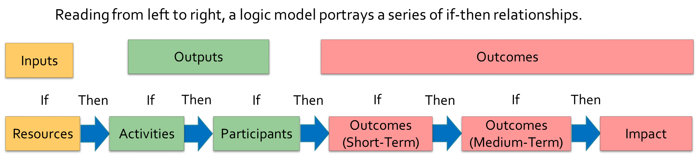
Tell me more…
See Handout pg. 5
Notes:
Logic models may be simple or detailed and complex depending upon your purpose and use.
Logic models come in many shapes, sizes and levels of detail
Multiple logic models, or nested logic models, may be necessary to characterize complex programs or multiple component initiatives.
If you have certain resources, then you will be able to provide activities, produce services or products for targeted individuals or groups. If you reach those individuals or groups, then they will benefit in certain specific ways in the short term. If the short-term benefits are achieved to the extent expected, then the medium-term benefits can be accomplished. If the medium-term benefits for participants/organizations/decision-makers are achieved to the extent expected, then you would expect the longer-term improvements and final impact in terms of social, economic, environmental, or civic changes to occur.

Slide 30
Everyday example
H
E
A
D
A
C
H
E
Get pills
Take pills
Feel better
Situation
INPUTS
OUTPUTS
OUTCOMES
Notes:
Let’s take a simple example – one that we can all relate to.
How many of us have had a headache at one time or another? (headache – SITUATION)
What do we do? Our experience may be that certain pills help
So, we need to get the pills (INPUTS),
Then we take the pills (OUTPUTS)
As a consequence, our headache goes away and we feel better. (OUTCOME)
Number of embedded assumption: assumes that we can find/get the needed pills; that we take the pills as prescribed; that the pills lead to improvement – not a stomach ache or other negative side effect. All programs have such assumptions – often the basis for failure or less than expected results
But, you can see the logic of the diagram and the end results – the impact that is expected. What really matters isn’t whether we get the pills and take the pills, but whether we feel better as a result

Slide 31
INPUTS
ACTIVITES
OUTPUTS
SHORT-TERM OUTCOMES
INTERMEDIATE OUTCOMES
LONG TERM OUTCOMES
REQUIRED COMPONENTS OF LOGIC MODEL: TEMPLATE
“What we invest”
The resources that go into a program or intervention. Can include financial, personnel, and in-kind resources from any source.
Examples:
Various funding sources for your program.
Your partners.
Staff time and technical assistance.
“What we do”
Events undertaken by the program or partners to produce desired outcomes.
Examples:
Assess the level and nature of stigma in a key subpopulation
Train health care partners and staff to reduce stigma
Develop an anti-stigma health communication campaign
“What we get”
Direct, tangible results of activities
Examples:
Data related to stigma in a key subpopulation
Health care professionals trained tor educe stigma
Health communication campaigns developed.
“What we achieve”
Desired results of the program. Describing outcomes as short, intermediate, or long term depends on the objective, the length of the program, and expectations of the program or intervention.
Immediate effects of the program or intervention activities. They often focus on the knowledge and attitudes of the intended audience.
Examples:
Increase knowledge of stigma in a key subpopulation
Decreased stigma in health care staff.
Better awareness the effects of stigma and opioid use disorder
Behavior, normative, and policy changes.
Examples:
Increased utilization of health care resources by people who use drugs
Increased delivery of naloxone and other harm reduction resources in health care settings
Desired results of the program and can take years to accomplish.
Examples:
Decrease in fatal and non-fatal overdoses
Increase in the number of people who use drugs in active recovery

Slide 32
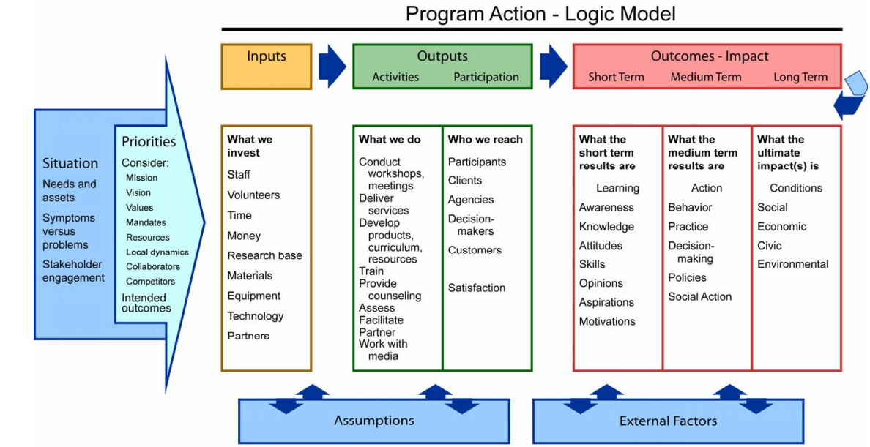

Slide 33
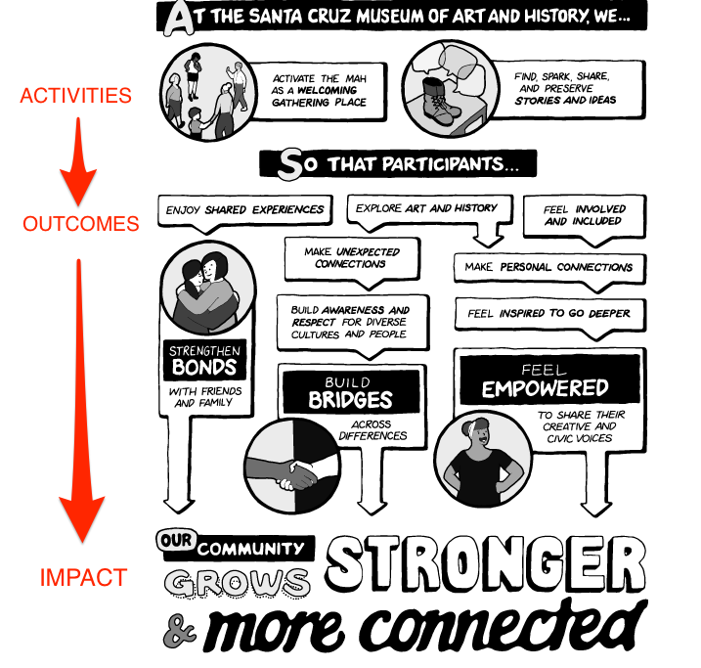
Notes:
Lo

Slide 34
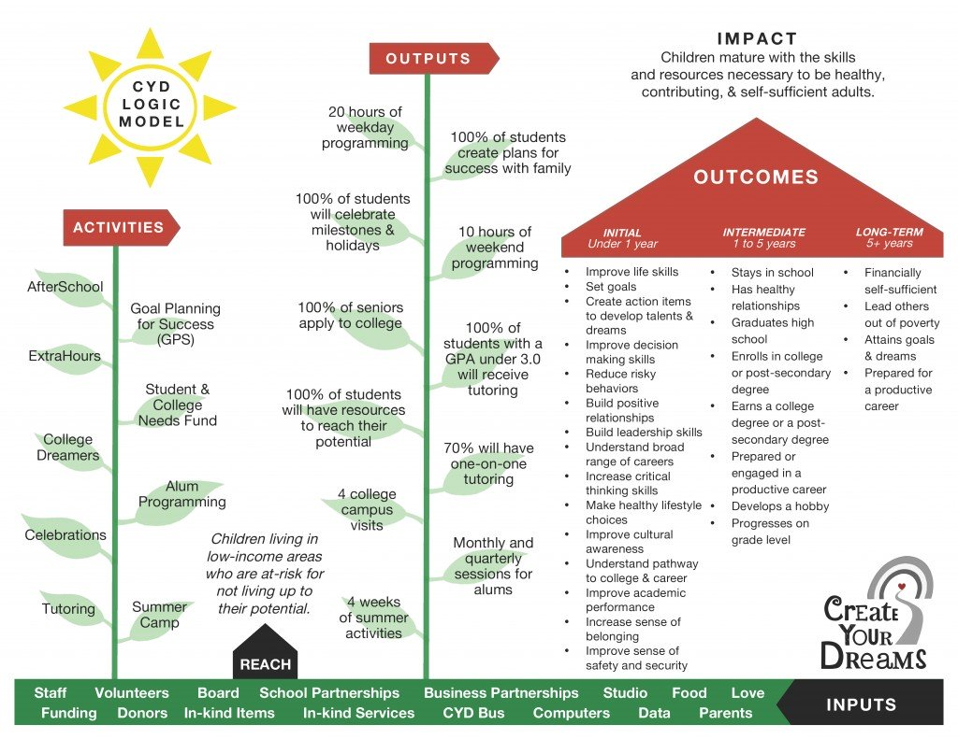
Notes:
Lo

Slide 35
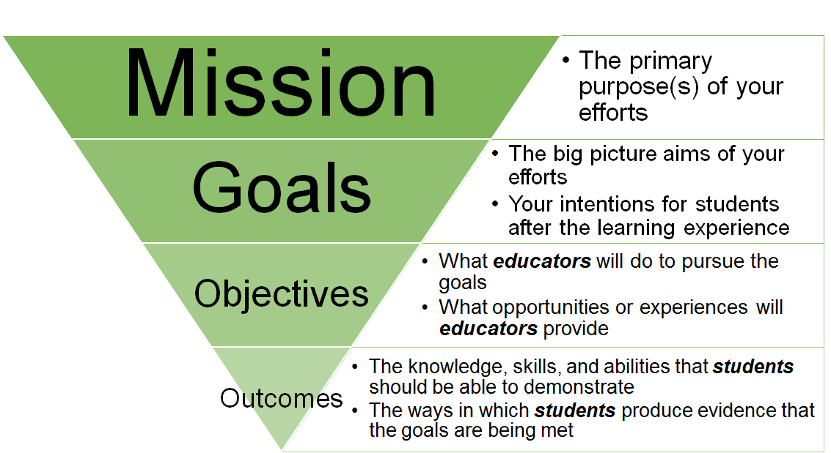
What is an Outcome?
The SO WHAT
IF/THEN. Outcomes are the THEN.
Notes:
Outcomes. SO WHAT! What results: the value or changes for individuals, families, groups, agencies, businesses, communities, and/or systems. IF/THEN. Outcomes are the THEN.
Outcomes include: short-term benefits such as changes in awareness, knowledge, skills, attitudes, opinions and intent and medium-term benefits such as changes in behaviors, decision-making and actions.
Can also include long-term benefits (often called impact see below).
Impact. The social, economic, civic and/or environmental consequences of the program. Impacts tend to be longer-term and so may be equated with goals.
Impact indicator. Expression or indication of impact. Evidence that the impact has/is being achieved.
What is the difference between process objectives and outcome objectives and the logic model lingo? Check with the people and organizations using these words to understand what they mean. In general, process objectives may be similar to outputs (how the program is implemented) and outcome objectives may be similar to outcomes (what the program is expected to achieve).
If you have certain resources, then you will be able to provide activities, produce services or products for targeted individuals or groups. If you reach those individuals or groups, then they will benefit in certain specific ways in the short term. If the short-term benefits are achieved to the extent expected, then the medium-term benefits can be accomplished. If the medium-term benefits for participants/organizations/decision-makers are achieved to the extent expected, then you would expect the longer-term improvements and final impact in terms of social, economic, environmental, or civic changes to occur.

Slide 36
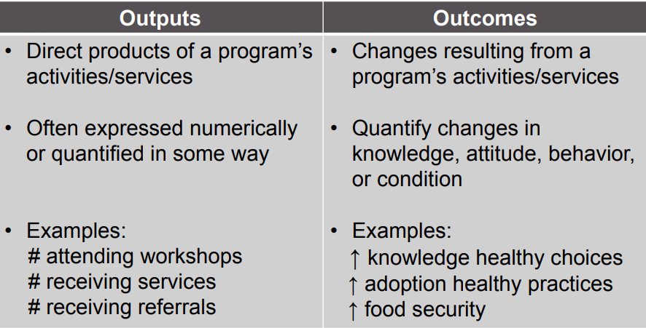
Outcome vs. Output
  “Not how many worms the bird feed its young, but how well the fledgling flies” (United Way, 1999)
Notes:
One of the most important distinctions in logic model development is the difference between outputs and outcomes what we do VERSUS what results (outcomes-benefits). An exercise I present in my workshop to highlight the difference between outputs and outcomes revolves around hamburgers. McDonald’s sells approximately 33 million hamburgers a day. Five Guys sells approximately 350,000 burgers daily. Based on this information, I ask participants to decide who makes a better burger. Would you conclude that McDonald’s makes a better hamburger based on this data alone? Of course not! Just like my participants, you would want data around quality, nutrition, and taste before making this decision.
Unfortunately, many nonprofit and social service organizations are merely counting “hamburgers” and trying to use these data as proof of their effectiveness or impact. They are spending all their efforts trying to increase the numbers they serve without knowing how their services are changing their participant’s lives or circumstances.

Slide 37
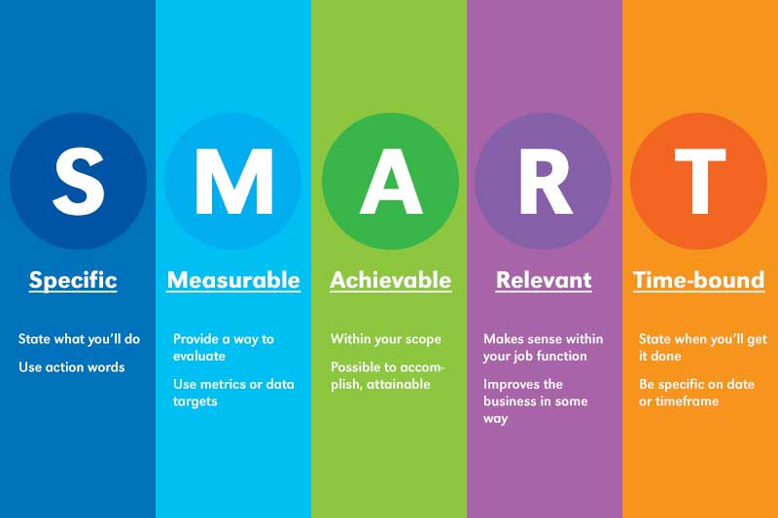
Measurable Outcomes
Notes:
Measurable is going to be a key piece here. We don’t need to identify a specific measure right now, but we need to be able to see how a specific outcome would be measured. Something else to consider is what you’ll do with the data once you have them.
We often don’t have the resources to evaluate “everything”. So we need to identify outcome priorities. So in going forward let’s think about the top priorities of the Market exhibit

Slide 38
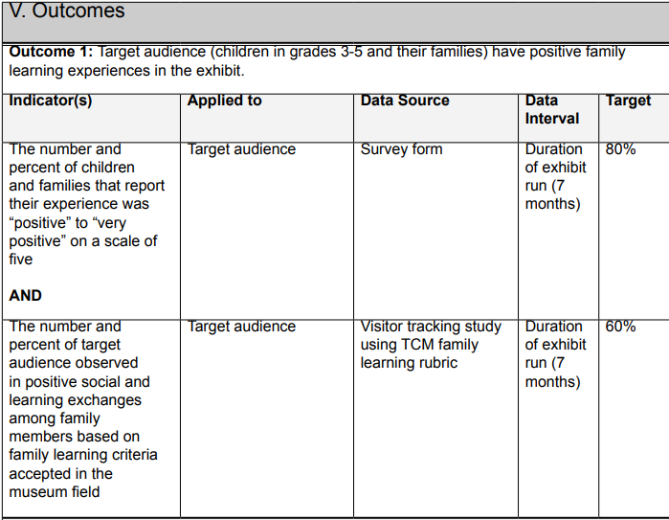
Example
Source: http://www.shapingoutcomes.org/course/cases/index.htm
Notes:
Measurable is going to be a key piece here. We don’t need to identify a specific measure right now, but we need to be able to see how a specific outcome would be measured. Something else to consider is what you’ll do with the data once you have them.
We often don’t have the resources to evaluate “everything”. So we need to identify outcome priorities. So in going forward let’s think about the top priorities of the Market exhibit

Slide 39
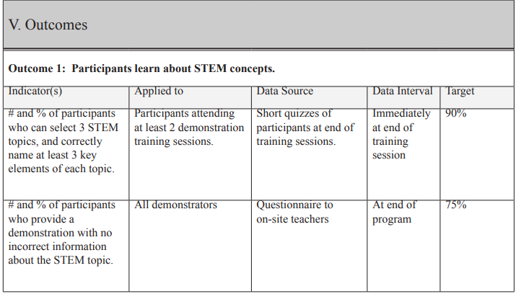
Example
Source: http://www.shapingoutcomes.org/course/cases/index.htm
Notes:
Measurable is going to be a key piece here. We don’t need to identify a specific measure right now, but we need to be able to see how a specific outcome would be measured. Something else to consider is what you’ll do with the data once you have them.
We often don’t have the resources to evaluate “everything”. So we need to identify outcome priorities. So in going forward let’s think about the top priorities of the Market exhibit

Slide 40
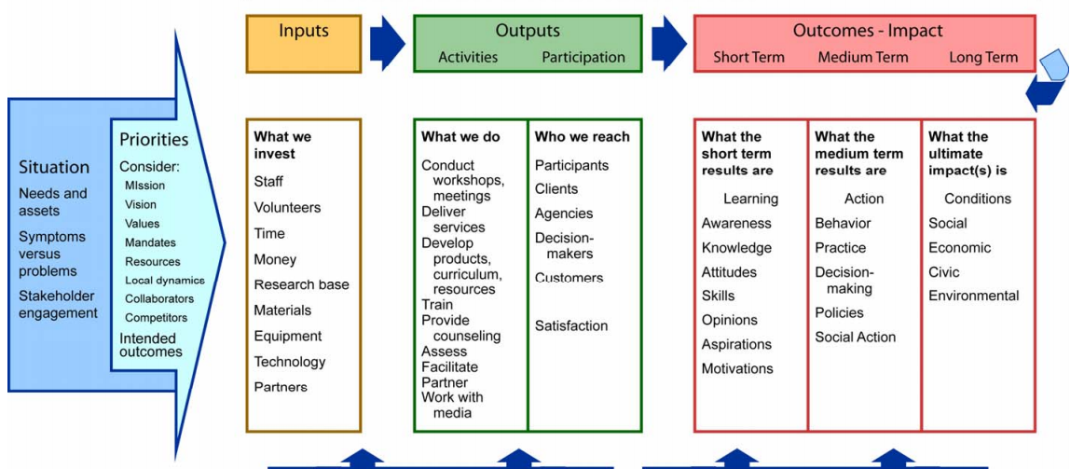
Notes:
Start with these parts today

Slide 41
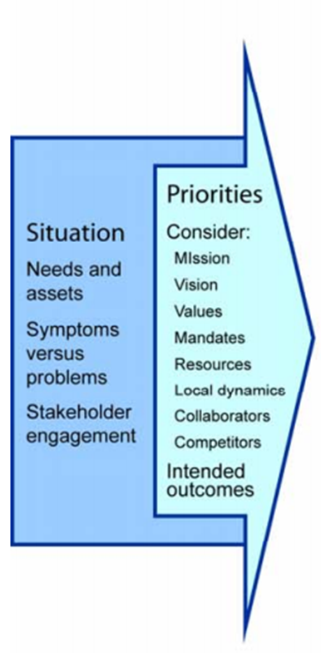
Step 1. Big Picture
Identify problem of interest (situational analysis) and long-term outcomes
Notes:
Start at the end. What is your long-term desired outcome?
Does the highest-level outcome represent a meaningful benefit of value to the public? Does it have inherent value? Can it be associated with the program?
Consider:
Does the highest-level outcome represent a meaningful benefit of value to the public?
Can it be associated with the program?

Slide 42
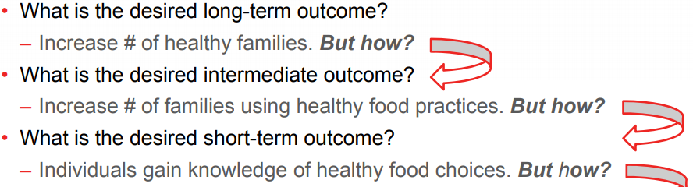
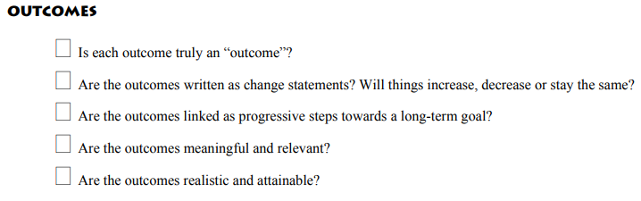
Step 2. Outcomes
Move backwards and identify the chain of outcomes that lead to the final, long-term result.
Starting at the impact level and ask “how?” How are we going to produce these outcomes?
Notes:
2. Move backwards and identify the chain of outcomes that lead to the final, long-term result.
Starting at the impact level, and working backward, ask “how?” How are we going to produce these outcomes? The items immediately preceding an outcome should show “how.”
Once we’ve identify and prioritized what it is that we will measure, then we move to determining how we will measure it. What would be the indicators for the outcomes and process variables you’ve selected. How would you know it? Again, some of you have begun to lay this out in your evaluation plans…What data or evidence will you use to say/know that adoption has occurred; physical activity has increased; service linkages are better?

Slide 43
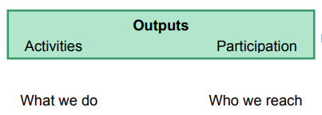

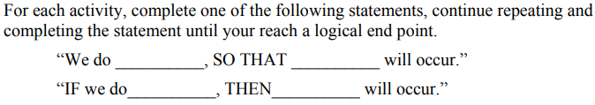
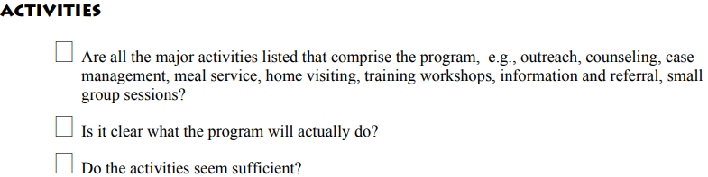
Step 3. Outputs – Activities
Notes:
OUTPUTS What we do and whom we reach: activities, services, events, products and the people reached. Outputs include such elements as workshops, conferences, counseling, products produced an
Move backwards: WHO must participate – who is expected to achieve the expected outcomes?
4. Move backwards: What ACTIVITIES must be provided/produced/completed so that the identified individuals (groups) will achieve the desired outcomes? If necessary, cluster activities into strategies (activities that fit together conceptually) such as training, media work, coalition development activities. d the individuals, clients, groups, families, and organizations targeted to be reached by the activities.

Slide 44
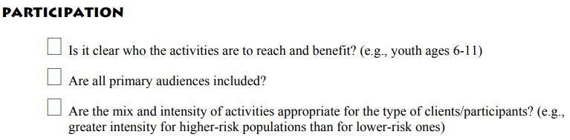
Step 3. Outputs - Participants
Notes:
OUTPUTS What we do and whom we reach: activities, services, events, products and the people reached. Outputs include such elements as workshops, conferences, counseling, products produced an
Move backwards: WHO must participate – who is expected to achieve the expected outcomes?

Slide 45
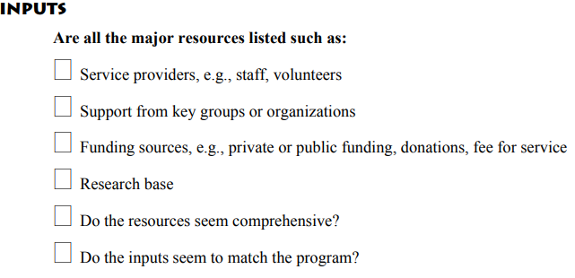
Step 4. Inputs
Resources and contributions that are invested. Inputs include such elements as staff, money, time, equipment, partnerships, etc.
Notes:
OUTPUTS What we do and whom we reach: activities, services, events, products and the people reached. Outputs include such elements as workshops, conferences, counseling, products produced an
Move backwards: WHO must participate – who is expected to achieve the expected outcomes?

Slide 46
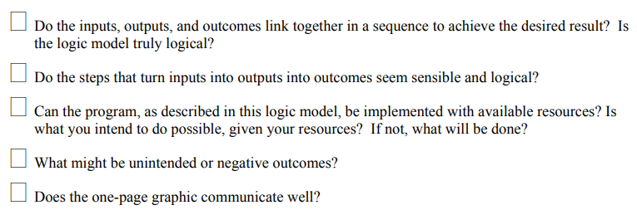
Step 5. Review Completed Logic Model
Notes:
OUTPUTS What we do and whom we reach: activities, services, events, products and the people reached. Outputs include such elements as workshops, conferences, counseling, products produced an
Move backwards: WHO must participate – who is expected to achieve the expected outcomes?

Slide 47
Next Steps
Set check in dates during the planning, design, prototyping, etc. phases to ensure we are on track and making adjustments as needed
Create an evaluation plan
Implement progress reporting tool

Slide 48
Up Next: Next Session’s Objectives
Board Development
Strengthening board capacity and relationship-building
ED vs. board roles
Legal guidelines
Agenda setting/effective meeting management basics

